Slide 1
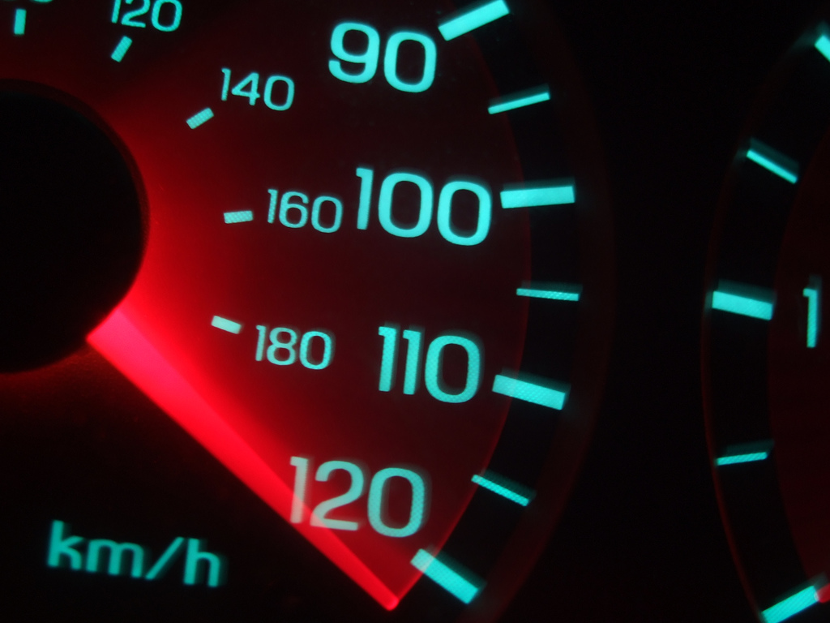
fast
by
default
http://stevesouders.com/docs/oredev-20091104.pptx
Disclaimer: This content does not necessarily reflect the opinions of my employer.
Notes:
YtseJam Photography, "Going nowhere fast", http://www.flickr.com/photos/thatguyfromcchs08/2300190277/

Slide 2
GMail Mobile: http://googlecode.blogspot.com/2009/09/gmail-for-mobile-html5-series-reducing.html
SproutCore: http://blog.sproutcore.com/post/225219087/faster-loading-through-eval
Google, Bing biz metrics: http://en.oreilly.com/velocity2009/public/schedule/detail/8523
Yahoo! biz metrics: http://www.slideshare.net/stoyan/yslow-20-presentation
Shopzilla biz metrics: http://en.oreilly.com/velocity2009/public/schedule/detail/7709
Netflix outbound traffic: http://en.oreilly.com/velocity2008/public/schedule/detail/3632
Google, Bing charts: http://www.watchingwebsites.com/archives/proof-that-speeding-up-websites-improves-online-business
Aptimize WAX: http://blogs.msdn.com/sharepoint/archive/2009/09/28/how-we-did-it-speeding-up-sharepoint-microsoft-com.aspx
Strangeloop Networks: http://www.watchingwebsites.com/archives/proof-that-speeding-up-websites-improves-online-business
SproutCore: http://blog.sproutcore.com/post/196959232/how-sproutcore-makes-your-app-run-faster
HTTP Archive Format: http://www.stevesouders.com/blog/2009/10/19/http-archive-specification-firebug-and-httpwatch/
@font-face: http://www.stevesouders.com/blog/2009/10/13/font-face-and-performance/

Slide 3
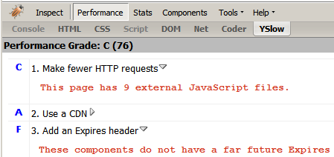

Slide 4
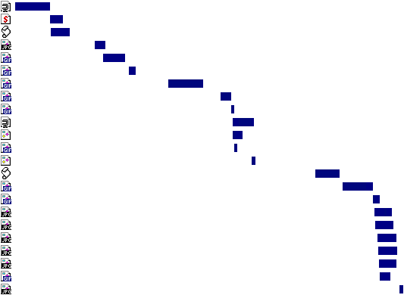
the importance of frontend performance
9%
91%
17%
83%
iGoogle, primed cache
iGoogle, empty cache
Notes:
Data source: Steve Souders
Tested on IE6 on Comcast cable modem (~5 mbps) medium powered PC, April 2008.

Slide 5
14 Rules
Make fewer HTTP requests
Use a CDN
Add an Expires header
Gzip components
Put stylesheets at the top
Put scripts at the bottom
Avoid CSS expressions
Make JS and CSS external
Reduce DNS lookups
Minify JS
Avoid redirects
Remove duplicate scripts
Configure ETags
Make AJAX cacheable
Notes:
photo courtesy of Vicki & Chuck Rogers: http://www.flickr.com/photos/two-wrongs/205467442/

Slide 6
Even Faster Web Sites
Splitting the initial payload
Loading scripts without blocking
Coupling asynchronous scripts
Positioning inline scripts
Sharding dominant domains
Flushing the document early
Using iframes sparingly
Simplifying CSS Selectors
Understanding Ajax performance..........Doug Crockford
Creating responsive web apps............Ben Galbraith, Dion Almaer
Writing efficient JavaScript.............Nicholas Zakas
Scaling with Comet.....................Dylan Schiemann
Going beyond gzipping...............Tony Gentilcore
Optimizing images...................Stoyan Stefanov, Nicole Sullivan

Slide 7
What makes sites feel slow
?

Slide 8
Google Mail
Notes:
3000 kbps up, 600kbps down
duo CPU Thinkpad X61
Windows XP
IE 7

Slide 9
Google Docs
Google Docs
Notes:
3000 kbps up, 600kbps down
duo CPU Thinkpad X61
Windows XP
IE 7

Slide 10
AOL
Notes:
3000 kbps up, 600kbps down
duo CPU Thinkpad X61
Windows XP
IE 7

Slide 11
Twitter
Notes:
3000 kbps up, 600kbps down
duo CPU Thinkpad X61
Windows XP
IE 7

Slide 12
ESPN
Notes:
3000 kbps up, 600kbps down
duo CPU Thinkpad X61
Windows XP
IE 7

Slide 13
Best Buy
Notes:
3000 kbps up, 600kbps down
duo CPU Thinkpad X61
Windows XP
IE 7

Slide 14
IKEA
Notes:
3000 kbps up, 600kbps down
duo CPU Thinkpad X61
Windows XP
IE 7

Slide 15
CNN
Notes:
3000 kbps up, 600kbps down
duo CPU Thinkpad X61
Windows XP
IE 7

Slide 16
(lack of)
Progressive Rendering

Slide 17
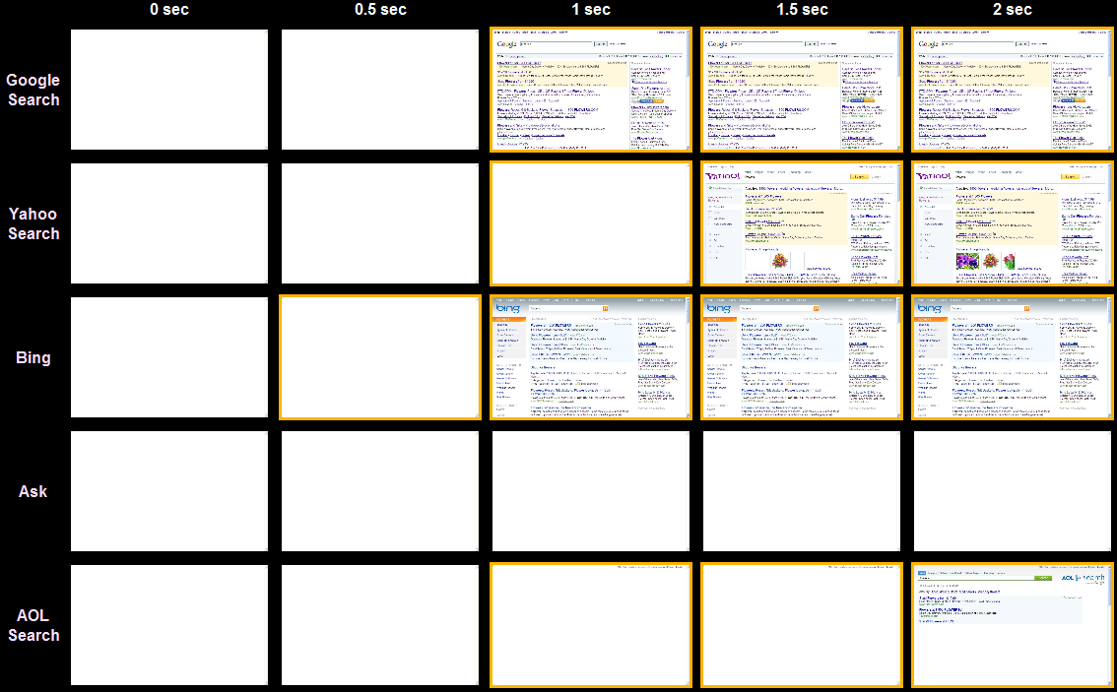
Search
Notes:
http://stevesouders.com/p3/index.php?sites=google-search,yahoo-search,bing,ask,aol-search&ival=500

Slide 18
WebPagetest.org
VA, UK, NZ
IE7, IE8
Dial, DSL, FIOS
empty, empty & primed
quad core
Pat Meenan (AOL)

Slide 19
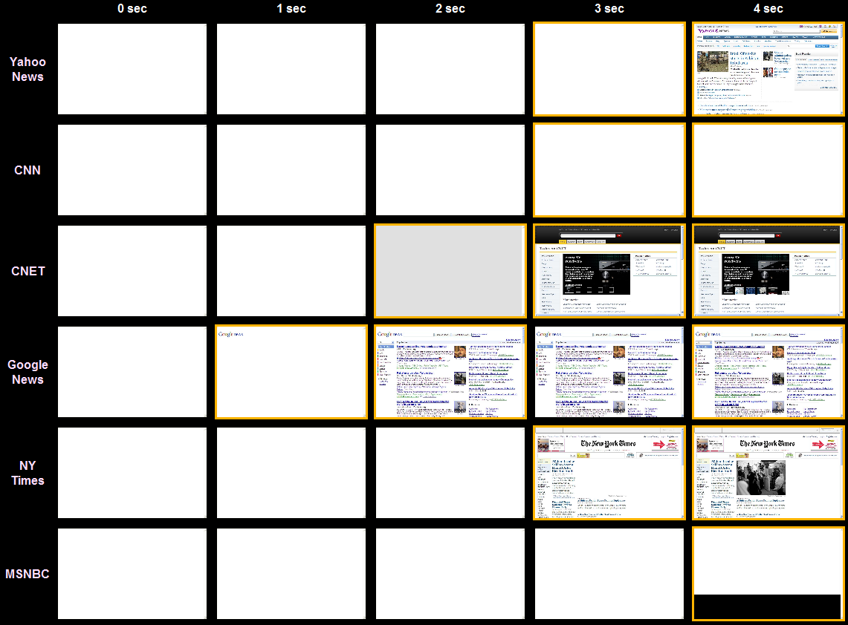
News
Notes:
http://stevesouders.com/p3/index.php?sites=yahoo-news,cnn,cnet,google-news,nytimes,msnbc,foxnews&ival=1000

Slide 20
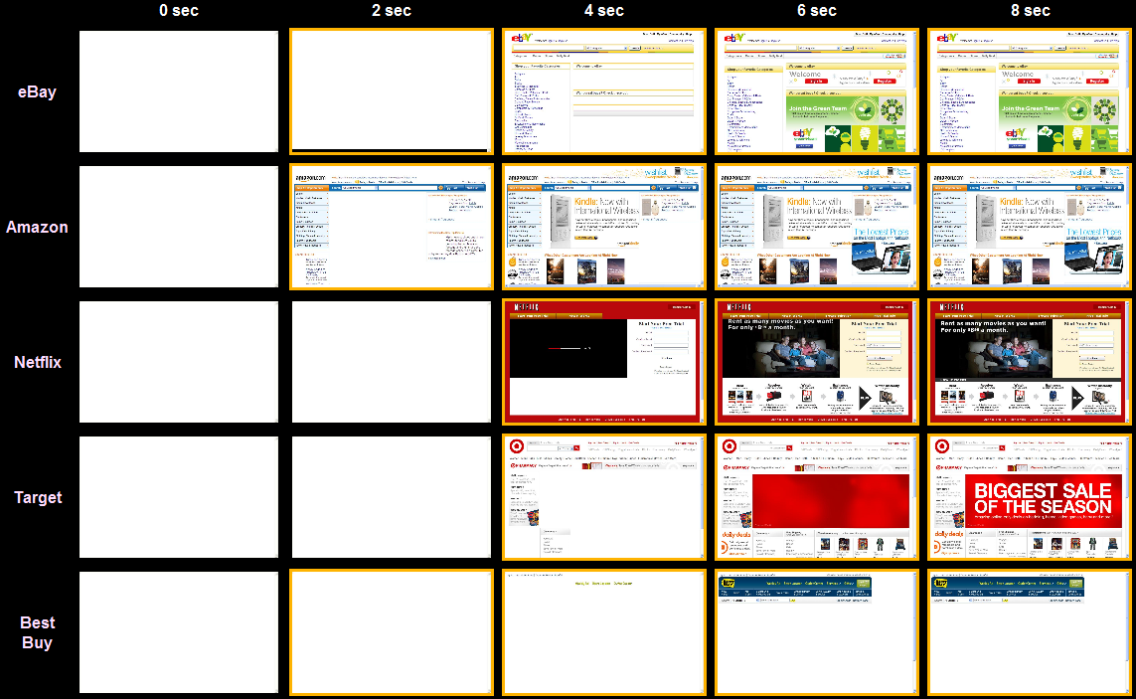
Shopping
Notes:
http://stevesouders.com/p3/index.php?sites=ebay,amazon,netflix,target,bestbuy,ikea&ival=2000

Slide 21
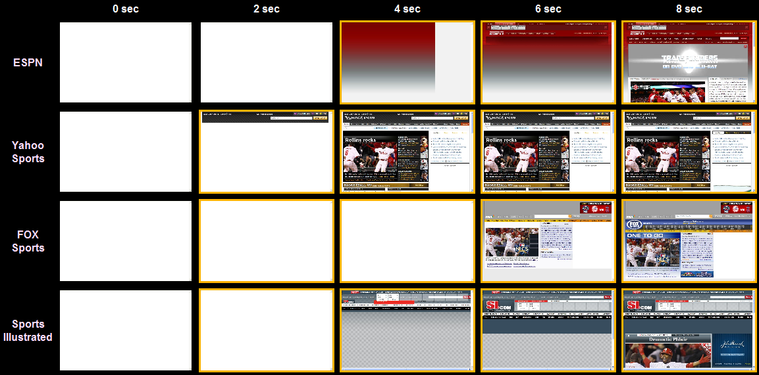
Sports
Notes:
http://stevesouders.com/p3/index.php?sites=ebay,amazon,netflix,target,bestbuy,ikea&ival=2000

Slide 22
Progressive Enhancement
deliver HTML
defer JS
avoid DOM
decorate later

Slide 23
Progressive Enhancement

Progressive Rendering

Slide 24
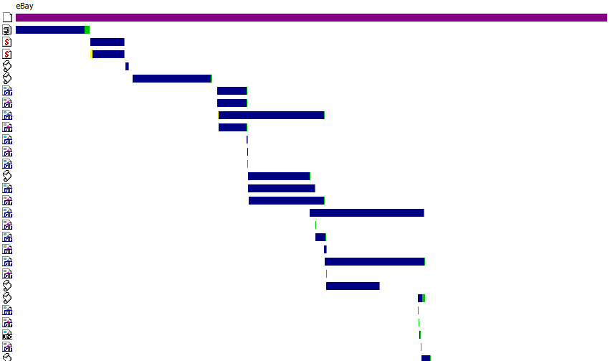
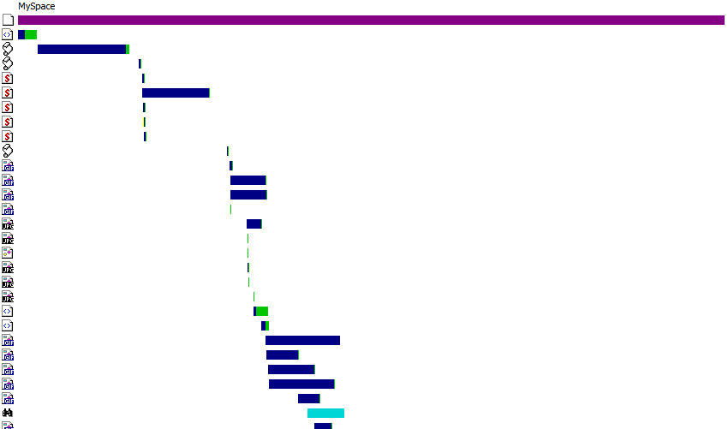
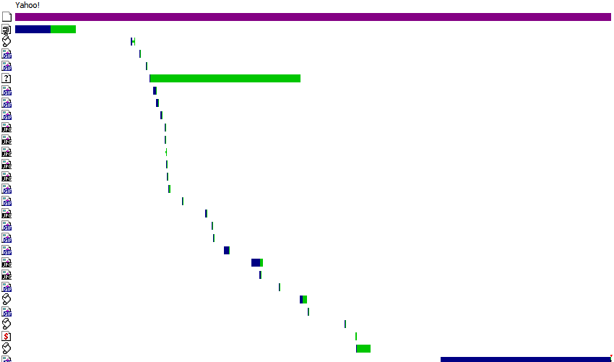
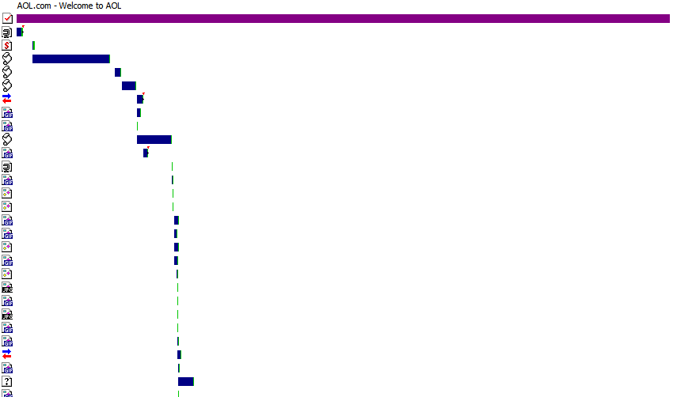
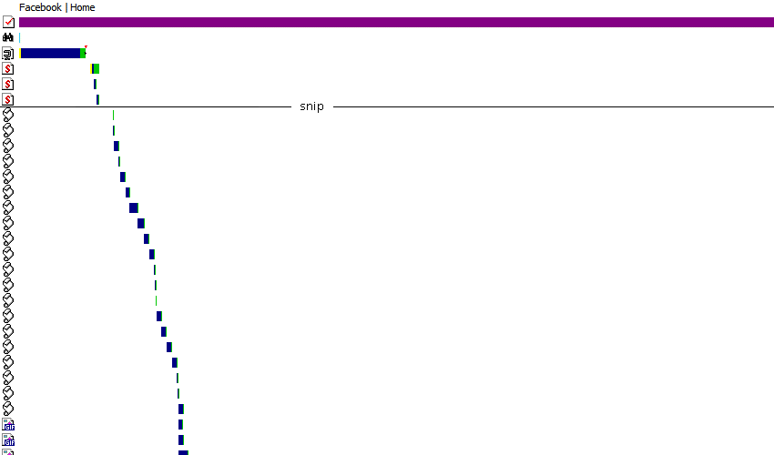
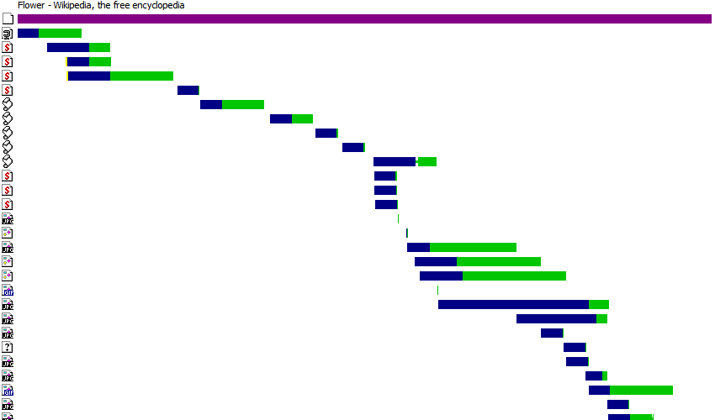
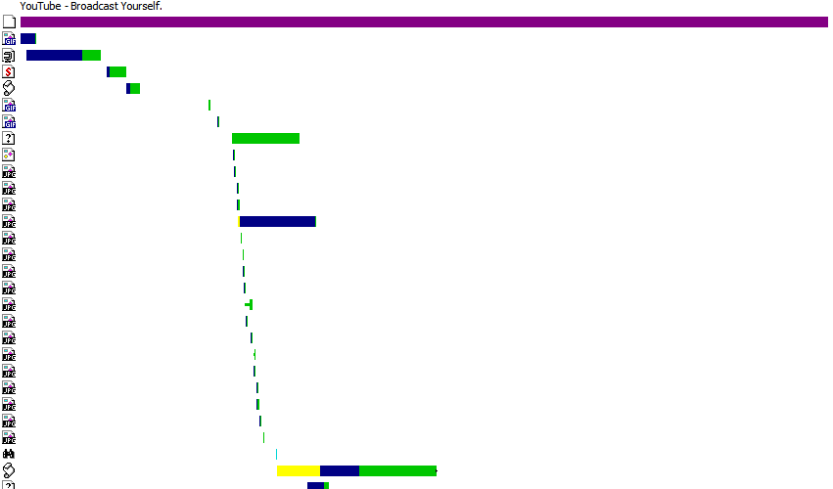
Why focus on JavaScript?
Yahoo!
Wikipedia
eBay
AOL
MySpace
YouTube
Facebook
Notes:
Data Source: Steve Souders
aol 76%
ebay 45%
facebook 41%
google 42%
live search 9%
msn 37%
myspace 37%
yahoo 45%
youtube 60%
wikipedia 26%
average 42%

Slide 25
scripts block
<script src="A.js"> blocks parallel downloads and rendering
9 secs: IE 6-7, FF 3.0, Chr 1, Op 9-10, Saf 3
7 secs: IE 8, FF 3.5, Chr 3, Saf 4

Slide 26
initial payload and execution
 | JavaScript | Functions Executed before onload
www.aol.com | 115K | 30%
www.ebay.com | 183K | 44%
www.facebook.com | 1088K | 9%
www.google.com/search | 15K | 45%
search.live.com/results | 17K | 24%
www.msn.com | 131K | 31%
www.myspace.com | 297K | 18%
en.wikipedia.org/wiki | 114K | 32%
www.yahoo.com | 321K | 13%
www.youtube.com | 240K | 18%
252K avg
26% avg
Notes:
Data source: Steve Souders

Slide 27
splitting the initial payload
split your JavaScript between what's needed to render the page and everything else
defer "everything else"
split manually (Page Speed), automatically (Microsoft Doloto)
load scripts without blocking – how?
Notes:
Permission to use photo given by Brian.H - http://flickr.com/photos/robinofloxley/750220669/

Slide 28
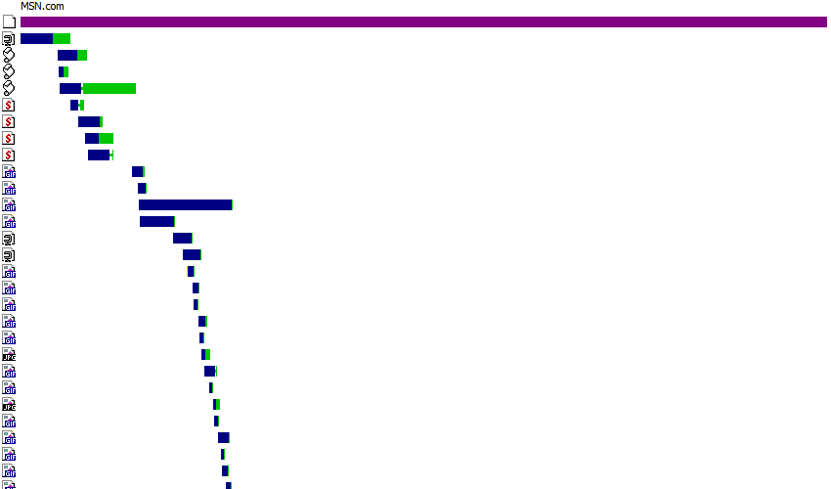
MSN.com: parallel scripts
MSN
Scripts and other resources downloaded in parallel! How? Secret sauce?!
var p=
g.getElementsByTagName("HEAD")[0];
var c=g.createElement("script");
c.type="text/javascript";
c.onreadystatechange=n;
c.onerror=c.onload=k;
c.src=e;
p.appendChild(c)
Notes:
Of the ten top sites, MSN.com (Script DOM Element), Live Search (Script in Iframe), and Yahoo (Script DOM Element) use advanced script loading techniques.

Slide 29
Loading Scripts Without Blocking
XHR Eval
XHR Injection
Script in Iframe
Script DOM Element
Script Defer
document.write Script Tag
Notes:
All of these allow for parallel downloads, but none of them allow for parallel JS execution – that's not possible (currently, WebKit is doing some stuff on that).

Slide 30
XHR Eval
var xhrObj = getXHRObject();
xhrObj.onreadystatechange =
function() {
if ( xhrObj.readyState != 4 ) return;
eval(xhrObj.responseText);
};
xhrObj.open('GET', 'A.js', true);
xhrObj.send('');
script & page must be same domain
massage script?

Slide 31
XHR Injection
var xhrObj = getXHRObject();
xhrObj.onreadystatechange =
function() {
if ( xhrObj.readyState != 4 ) return;
var se=document.createElement('script');
document.getElementsByTagName('head')
[0].appendChild(se);
se.text = xhrObj.responseText;
};
xhrObj.open('GET', 'A.js', true);
xhrObj.send('');
script must have same domain as main page

Slide 32
Script in Iframe
<iframe src='A.html' width=0 height=0
frameborder=0 id=frame1></iframe>
iframe must have same domain as main page
must refactor script:
// access iframe from main page
window.frames[0].createNewDiv();
// access main page from iframe
parent.document.createElement('div');

Slide 33
Script DOM Element
var se = document.createElement('script');
se.src = 'http://anydomain.com/A.js';
document.getElementsByTagName('head')
[0].appendChild(se);
script & page domains can differ
no need to massage JavaScript
may not preserve execution order

Slide 34
GMail Mobile
<script type="text/javascript">
/*
var ...
*/
</script>
get script DOM element's text
remove comments
eval() when invoked
inline or iframe
awesome for prefetching JS that might (not) be needed
Notes:
GMail Mobile: http://googlecode.blogspot.com/2009/09/gmail-for-mobile-html5-series-reducing.html
SproutCore: http://blog.sproutcore.com/post/225219087/faster-loading-through-eval

Slide 35
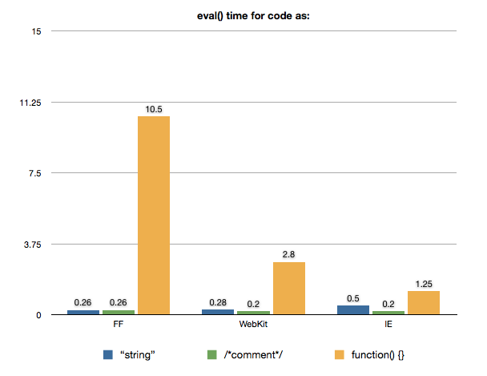
SproutCore
var module1 = "...";
var module2 = "...";
eval() modules as needed
2nd fastest downloading
2nd fastest loading symbols
best alternative
Notes:
GMail Mobile: http://googlecode.blogspot.com/2009/09/gmail-for-mobile-html5-series-reducing.html
SproutCore: http://blog.sproutcore.com/post/225219087/faster-loading-through-eval

Slide 36
Script Defer
<script defer src='A.js'></script>
supported in IE and FF 3.1+
script and main page domains can differ
no need to refactor JavaScript

Slide 37
document.write Script Tag
document.write("<script type='text/javascript' src='A.js'> <\/script>");
parallelization only works in IE
parallel downloads for scripts, nothing else
all document.writes must be in same script block

Slide 38
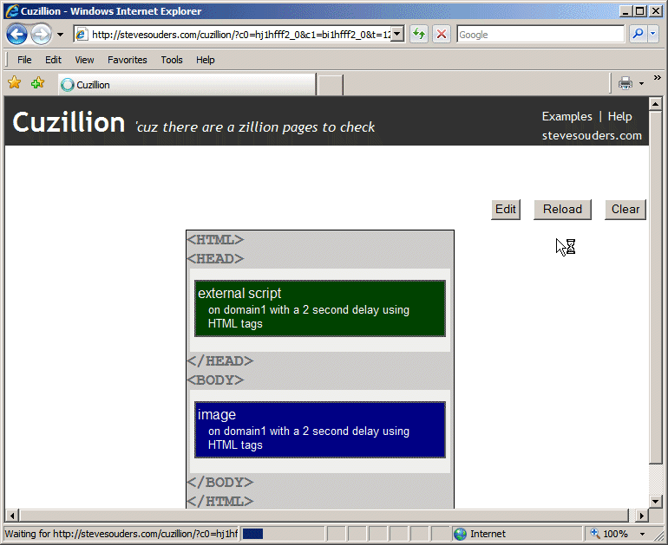
browser busy indicators
Notes:
Audio (IE "click") is another busy indicator.
Delayed rendering and delayed onload ("done") are other busy indicators.
Sometimes busy indicators are bad, sometimes good.

Slide 39
Load Scripts Without Blocking
 | || down-loads | domains can differ | existing scripts | browser busy | ensures order | size (bytes)
normal Script Src | no | yes | yes | IE,FF | IE,FF | ~50
XHR Eval | IE,FF | no | no | no | no | ~500
XHR Injection | IE,FF | no | yes | no | no | ~500
Script in Iframe | IE,FF | no | no | IE,FF | no | ~50
Script DOM Element | IE,FF | yes | yes | FF | FF | ~200
Script Defer | IE | yes | yes | IE,FF | IE | ~50
document.write Script Tag | IE* | yes | yes | IE,FF | IE | ~100
*Only other document.write scripts are downloaded in parallel (in the same script block).
Notes:
Data source: Steve Souders

Slide 40
and the winner is...
XHR Eval
XHR Injection
Script in iframe
Script DOM Element
Script Defer
different domains
same domains
Script DOM Element
Script Defer
no order
preserve order
XHR Eval
XHR Injection
Script in iframe
Script DOM Element (IE)
Script DOM Element (FF)
Script Defer (IE)
Managed XHR Eval
Managed XHR Injection
no order
preserve order
Script DOM Element
Script DOM Element (FF)
Script Defer (IE)
no busy
show busy
Managed XHR Injection
Managed XHR Eval
Script DOM Element (FF)
Script Defer (IE)
Managed XHR Eval
Managed XHR Injection
no busy
show busy
XHR Injection
XHR Eval
Script DOM Element (IE)
Managed XHR Injection
Managed XHR Eval
Script DOM Element
Notes:
I'll do JavaScript and PHP implementations of this logic soon.

Slide 41
bad: stylesheet followed by inline script
stylesheets load in parallel with other resources...
...unless followed by an inline script
put inline JS above stylesheets or below other resources
use Link, not @import
Notes:
Joseph Smarr from Plaxo advocates interspersing setTimeout through JavaScript threads every n00 ms.

Slide 42
mispositioned inline scripts
MSN
Wikipedia
eBay
MySpace
Notes:
Data source: Steve Souders

Slide 43
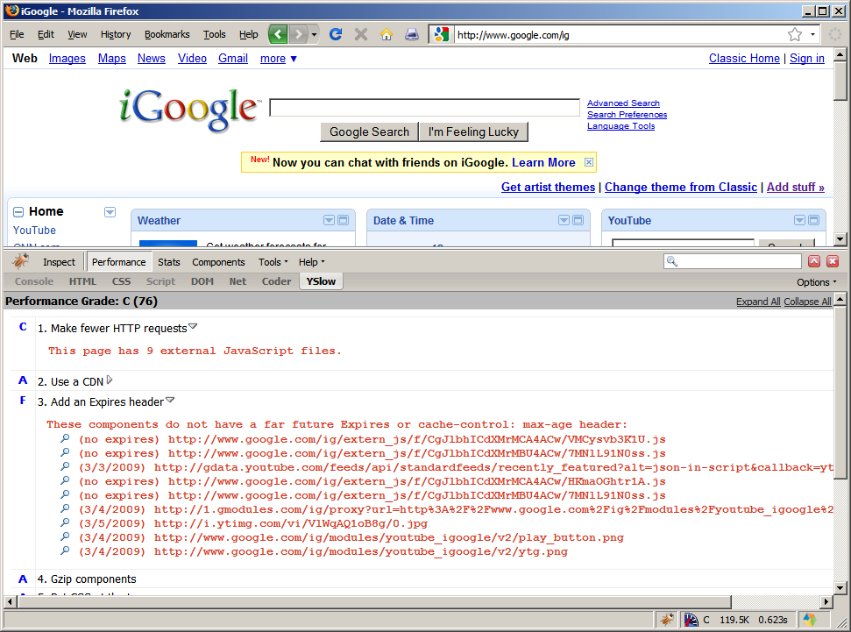

Slide 44
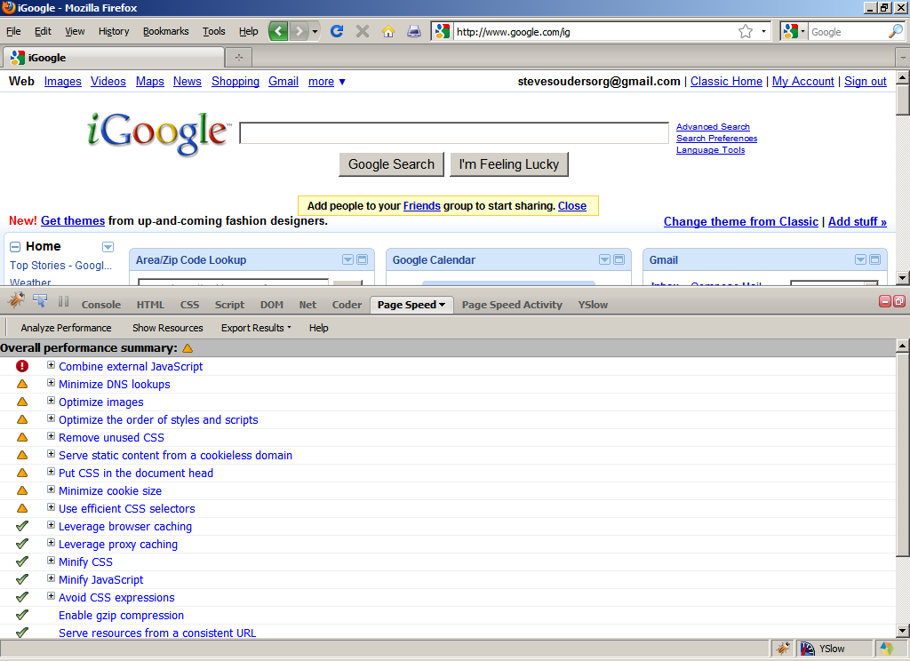

Slide 45
Both
combine scripts
combine stylesheets
add an Expires header
gzip responses
put stylesheets at the top
put scripts at the bottom
avoid CSS expressions
make JS and CSS external
reduce DNS lookups
minify JS and CSS
avoid redirects
remove duplicate scripts
make Ajax cacheable
reduce cookie size
use cookie-free domains
don't scale images
YSlow
use CSS sprites
use a CDN
configure ETags
use GET for Ajax requests
reduce # of DOM elements
no 404s
avoid image filters
optimize favicon
Page Speed
defer loading JS
remove unused CSS
use efficient CSS selectors
optimize images
optimize order of CSS & JS
shard domains
leverage proxy caching

Slide 46
reduce HTTP
use a CDN
add Expires
gzip
minify
configure ETags
Notes:
more carrot, less stick – when forced to consume, people are less likely to buy-in so it doesn't stick, can't lead a horse to water AND force it to drink, make it so they're seeking out the water

Slide 47
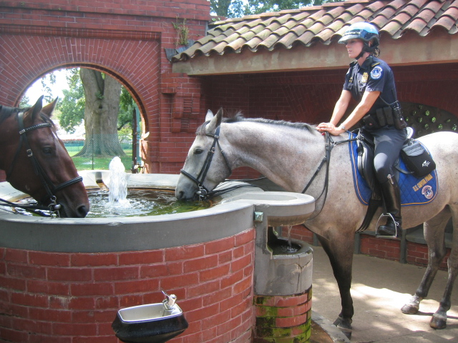
Notes:
more carrot, less stick – when forced to consume, people are less likely to buy-in so it doesn't stick, can't lead a horse to water AND force it to drink, make it so they're seeking out the water

Slide 48
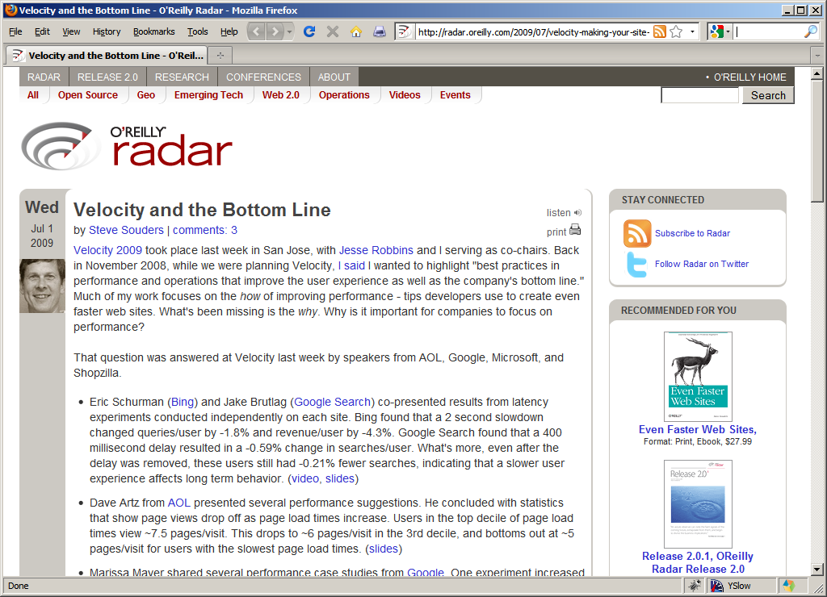

Slide 49
Google
+ 0.4 sec
searches ⬇ 0.6%
Notes:
Google, Bing: http://en.oreilly.com/velocity2009/public/schedule/detail/8523
Yahoo!: http://www.slideshare.net/stoyan/yslow-20-presentation
Shopzilla: http://en.oreilly.com/velocity2009/public/schedule/detail/7709
Netflix: http://en.oreilly.com/velocity2008/public/schedule/detail/3632

Slide 50
Yahoo!
+ 0.4 sec
traffic ⬇ 5-9%
Notes:
Google, Bing: http://en.oreilly.com/velocity2009/public/schedule/detail/8523
Yahoo!: http://www.slideshare.net/stoyan/yslow-20-presentation
Shopzilla: http://en.oreilly.com/velocity2009/public/schedule/detail/7709
Netflix: http://en.oreilly.com/velocity2008/public/schedule/detail/3632

Slide 51
Bing
+2 sec
revenue ⬇ 4.3%
Notes:
Google, Bing: http://en.oreilly.com/velocity2009/public/schedule/detail/8523
Yahoo!: http://www.slideshare.net/stoyan/yslow-20-presentation
Shopzilla: http://en.oreilly.com/velocity2009/public/schedule/detail/7709
Netflix: http://en.oreilly.com/velocity2008/public/schedule/detail/3632

Slide 52
Shopzilla
-5 sec
revenue ⬆ 12%
hw ⬇ 50%
Notes:
Google, Bing: http://en.oreilly.com/velocity2009/public/schedule/detail/8523
Yahoo!: http://www.slideshare.net/stoyan/yslow-20-presentation
Shopzilla: http://en.oreilly.com/velocity2009/public/schedule/detail/7709
Netflix: http://en.oreilly.com/velocity2008/public/schedule/detail/3632

Slide 53
Netflix
outbound bandwidth ⬇ 43%
Notes:
Google, Bing: http://en.oreilly.com/velocity2009/public/schedule/detail/8523
Yahoo!: http://www.slideshare.net/stoyan/yslow-20-presentation
Shopzilla: http://en.oreilly.com/velocity2009/public/schedule/detail/7709
Netflix: http://en.oreilly.com/velocity2008/public/schedule/detail/3632

Slide 54
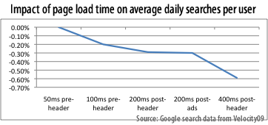
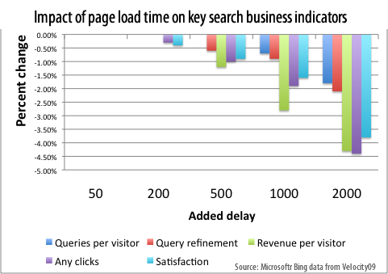
Notes:
http://www.watchingwebsites.com/archives/proof-that-speeding-up-websites-improves-online-business
0.21% decrease even 5 weeks after the delay was removed – users perception of a site is learned
Netflix: http://en.oreilly.com/velocity2008/public/schedule/detail/3632

Slide 55
fast performance =
better user experience
more traffic
more revenue
reduced costs

Slide 56
so...
why don't more people do it?

Slide 57
it's
too
hard!

Slide 58
Notes:
http://www.youtube.com/watch?v=m888nlVxZu8

Slide 59
"if it wasn't hard everyone would do it"
"the hard is what makes it great"

Slide 60
this year's theme:
Fast by Default

Slide 61
Aptimize WAX
concatenate scripts
concatenate stylesheets
sprites, data: URIs
far future Expires
minify JS and CSS
automatically in real time
Notes:
http://blogs.msdn.com/sharepoint/archive/2009/09/28/how-we-did-it-speeding-up-sharepoint-microsoft-com.aspx

Slide 62
WAX on:
http://sharepoint.microsoft.com
# requests empty: 96  35
# requests primed: 50  9
scripts 7, stylesheets 12, images 25
pages faster: 46-64% empty, 15-53% primed
Notes:
http://blogs.msdn.com/sharepoint/archive/2009/09/28/how-we-did-it-speeding-up-sharepoint-microsoft-com.aspx

Slide 63
Strangeloop Networks
"typical ecommerce site"
pages per visit: 11  16
time on site: 24  30 mins
conversions: •16%
order value: •5.5%
Notes:
http://www.watchingwebsites.com/archives/proof-that-speeding-up-websites-improves-online-business

Slide 64
Rails
far future Expires
concatenate scripts
domain sharding
configure ETags
in pipeline: async scripts, spriting, minification, flushing

Slide 65
SproutCore
concatenate scripts
concatenate stylesheets
versioning (future Expires)
stylesheets at the top
scripts at the bottom
minify JS & CSS
remove dupe scripts
Notes:
http://blog.sproutcore.com/post/196959232/how-sproutcore-makes-your-app-run-faster

Slide 66
WPO

Slide 67
news

Slide 68
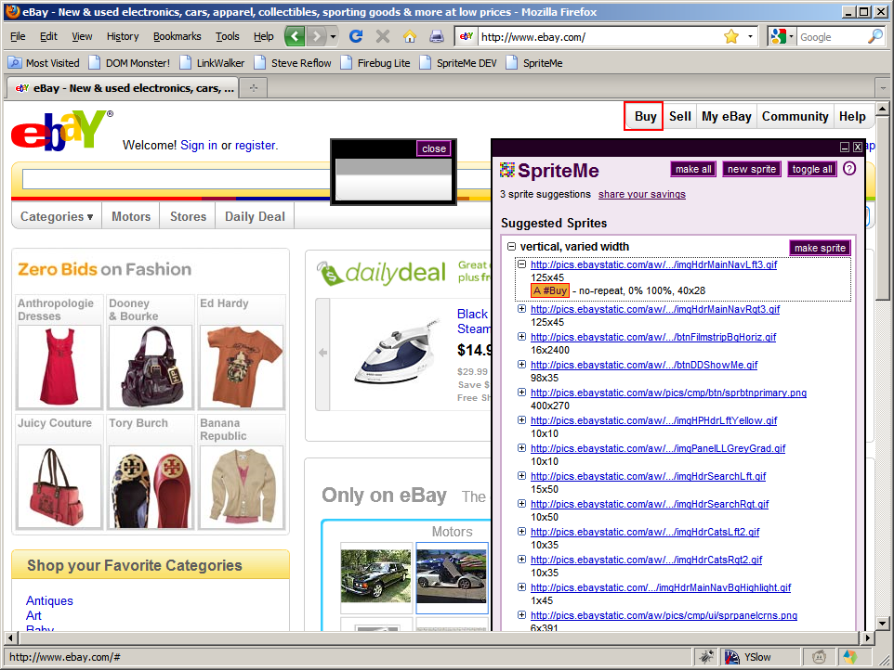
finds BG images
groups into sprites
generates sprite
recomputes BG pos
injects into page
http://spriteme.org/

Slide 69
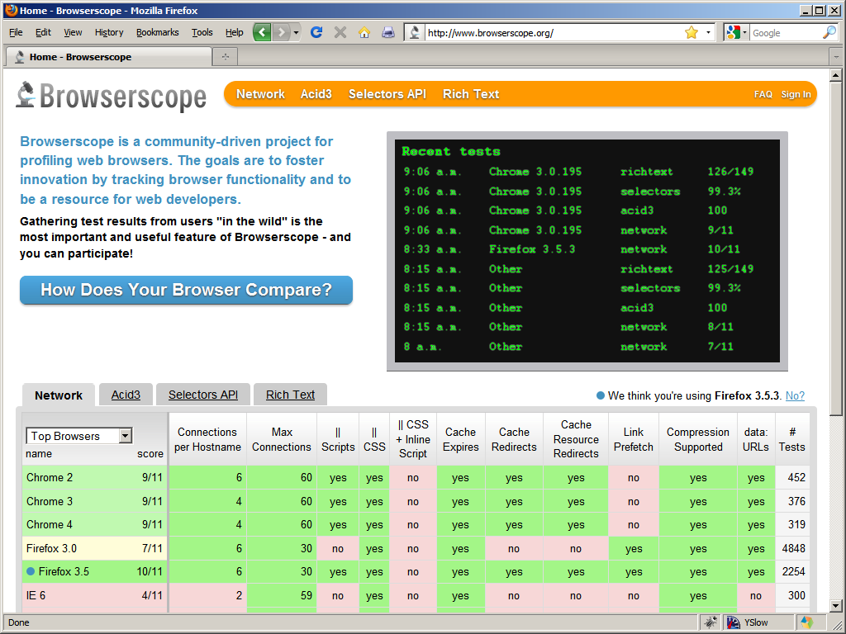
Browserscope

Slide 70
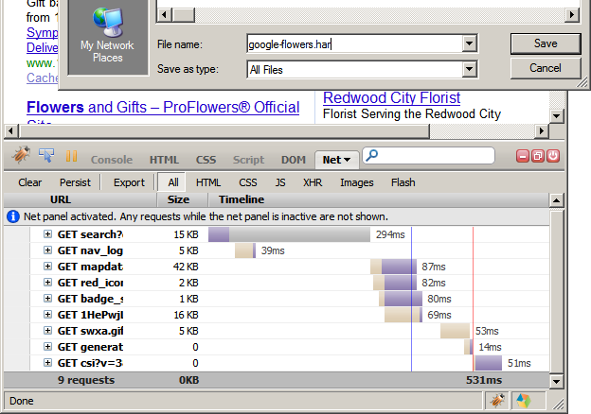
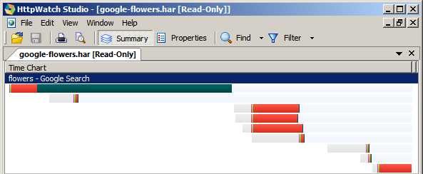
HTTP Archive Format
(HAR)
Notes:
http://www.stevesouders.com/blog/2009/10/19/http-archive-specification-firebug-and-httpwatch/

Slide 71
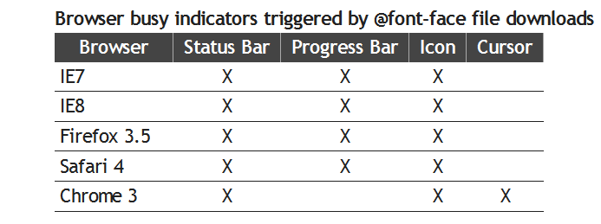
@font-face
blocks rendering in IE if below SCRIPT tag
declare above all SCRIPTs
Notes:
http://www.stevesouders.com/blog/2009/10/13/font-face-and-performance/

Slide 72
Velocity OnLine Conference
Dec 8, 9am-12:30pm PT
Hooman Beheshti (StrangeLoop)
Charles Jolley (SproutCore)
Matt Cutts (Google)
Artur Bergman (Wikia)
Damien Katz (CouchDB)
Notes:
http://www.stevesouders.com/blog/2009/10/13/font-face-and-performance/

Slide 73
takeaways
focus on the frontend
run YSlow
and Page Speed!
progressive enhancement  progressive rendering

Slide 74
SPEED is the next competitive advantage
use it
...before someone else does

Slide 75
Steve Souders
souders@google.com
http://stevesouders.com/docs/oredev-20091104.pptx
Notes:
"thank you" by nj dodge: http://flickr.com/photos/nj_dodge/187190601/

Slide 76
GMail Mobile: http://googlecode.blogspot.com/2009/09/gmail-for-mobile-html5-series-reducing.html
SproutCore: http://blog.sproutcore.com/post/225219087/faster-loading-through-eval
Google, Bing biz metrics: http://en.oreilly.com/velocity2009/public/schedule/detail/8523
Yahoo! biz metrics: http://www.slideshare.net/stoyan/yslow-20-presentation
Shopzilla biz metrics: http://en.oreilly.com/velocity2009/public/schedule/detail/7709
Netflix outbound traffic: http://en.oreilly.com/velocity2008/public/schedule/detail/3632
Google, Bing charts: http://www.watchingwebsites.com/archives/proof-that-speeding-up-websites-improves-online-business
Aptimize WAX: http://blogs.msdn.com/sharepoint/archive/2009/09/28/how-we-did-it-speeding-up-sharepoint-microsoft-com.aspx
Strangeloop Networks: http://www.watchingwebsites.com/archives/proof-that-speeding-up-websites-improves-online-business
SproutCore: http://blog.sproutcore.com/post/196959232/how-sproutcore-makes-your-app-run-faster
HTTP Archive Format: http://www.stevesouders.com/blog/2009/10/19/http-archive-specification-firebug-and-httpwatch/
@font-face: http://www.stevesouders.com/blog/2009/10/13/font-face-and-performance/

