Slide 1
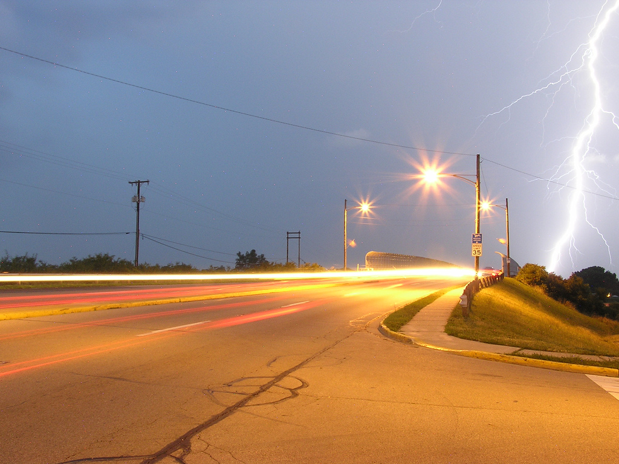
Even Faster Web Sites
stevesouders.com/docs/thinkvitamin-20101216.pptx
Disclaimer: This content does not necessarily reflect the
opinions of my employer.
flickr.com/photos/ddfic/722634166/

Slide 2
how exciting is web dev?
flickr.com/photos/joshme17/1557627176/

Slide 3
darn exciting!
flickr.com/photos/dougbrown47/4468708942//

Slide 4
carsonified.com/blog/business/fred-wilsons-10-golden-principles-of-successful-web-apps/
#1. Speed: “First and foremost, we believe that speed is more than a feature. Speed is the most important feature.”
Notes:
Fred Wilson is Managing Partner of two venture capital firms, Flatiron Partners (Yoyodyne, Geocities) and Union Square Ventures (Twitter, delicious, Etsy, Feedburner).
Speed
Instant utility
Software is media
Less is more
Make it programmable
Make it personal
RESTful
Discoverability
Clean
Playful

Slide 5
en.oreilly.com/velocity2009/public/schedule/detail/8523

Slide 6
en.oreilly.com/velocity2009/public/schedule/detail/8523

Slide 7
Yahoo!
0.4 sec slower
traffic ⬇ 5-9%
slideshare.net/stoyan/dont-make-me-wait-or-building-highperformance-web-applications
slideshare.net/stoyan/yslow-20-presentation

Slide 8
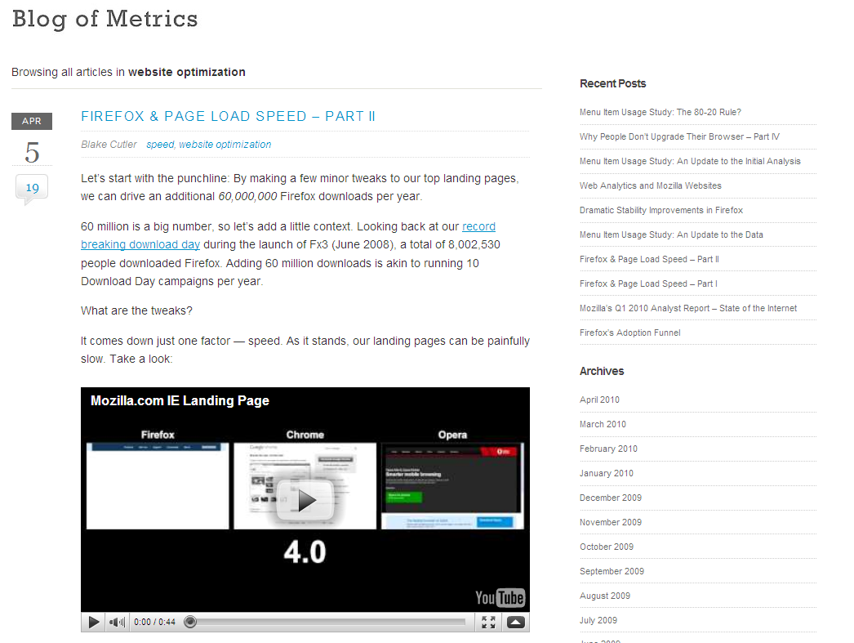
blog.mozilla.com/metrics/category/website-optimization/
…shaved 2.2 seconds off the average page load time and increased download conversions by 15.4%!
Notes:
“if we’re able to achieve a similar performance boost across our other top landing pages, we’ll drive in excess of 60 million yearly Firefox downloads.”

Slide 9
en.oreilly.com/velocity2009/public/schedule/detail/7709
blog.mozilla.com/metrics/category/website-optimization/
…shaved 2.2 seconds off the average page load time and increased download conversions by 15.4%!
Notes:
This was a ~5 second speed up.

Slide 10
en.oreilly.com/velocity2008/public/schedule/detail/3632

Slide 11
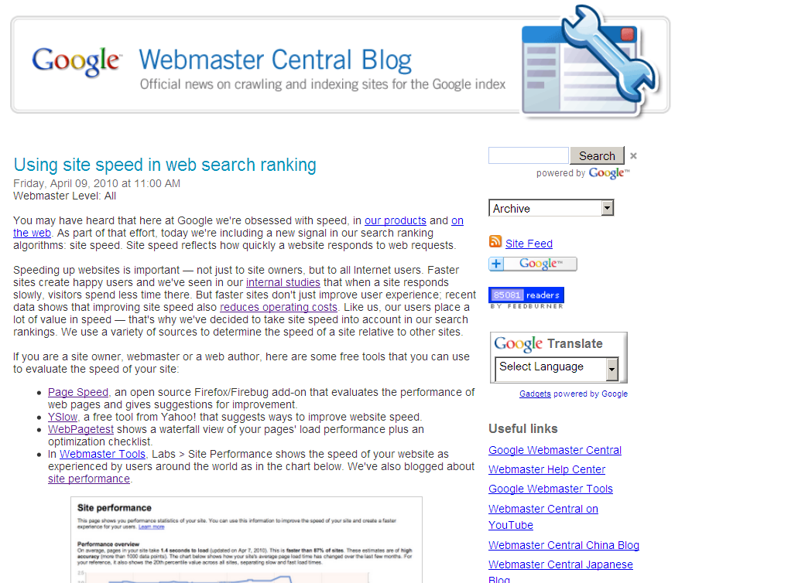
Site speed in search rank
…we've decided to take site speed into account in our search rankings.
Screen shot of blog post
googlewebmastercentral.blogspot.com/2010/04/using-site-speed-in-web-search-ranking.html
Notes:
Time measurements from real users.

Slide 12
Web
Performance
Optimization
WPO
drives traffic
improves UX
increases revenue
reduces costs
flickr.com/photos/pedromourapinheiro/3123885534/

Slide 13
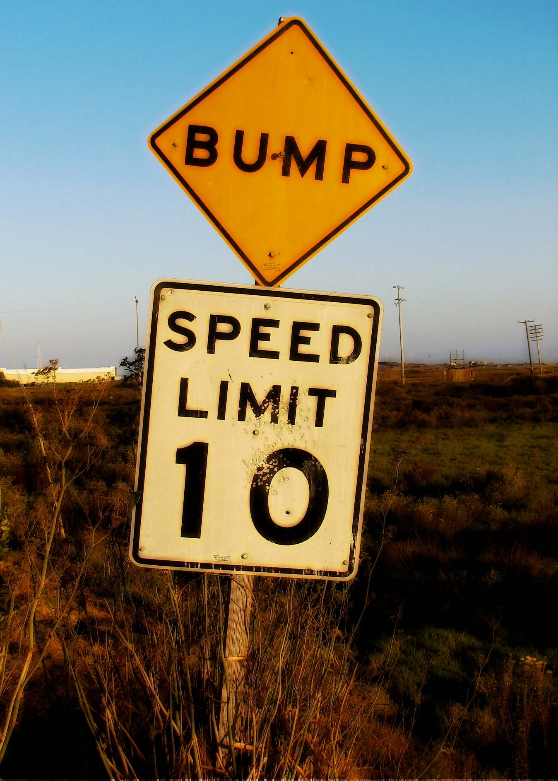
What makes sites feel slow?
flickr.com/photos/kevincollins/234678305/

Slide 14
(lack of)
Progressive Rendering
[next page being loaded]
flickr.com/photos/kevincollins/234678305/

Slide 15
Notes:
http://www.webpagetest.org/video/view.php?id=100630_734a5096ca2b97a217b756b277520c0a68e911d5.slow

Slide 16
Notes:
http://www.webpagetest.org/video/view.php?id=100608_ecbc76305fba361cafb31c0abd27d46617e65c24

Slide 17
Notes:
http://www.webpagetest.org/video/view.php?id=100608_ab0ebdaa528ad2c480ff16fb4e59e50a52bdd71f

Slide 18
Progressive Enhancement
deliver HTML
defer JS
avoid DOM
decorate later

Slide 19
Progressive Enhancement

Progressive Rendering

Slide 20
Why focus on JavaScript?
<script src="A.js"> blocks parallel downloads and rendering
9 secs: IE 6-7, FF 3.0, Chr 1, Op 9-10, Saf 3
7 secs: IE 8-9, FF 3.6, Chr 6, Saf 4

Slide 21
initial payload and execution
 | JavaScript | Functions Executed before onload
www.aol.com | 324 K | 30%
www.ebay.com | 234 K | 34%
www.facebook.com | 553 K | 7%
www.google.com/search | 21 K | ??%
www.bing.com/search | 10 K | 35%
www.msn.com | 152 K | 55%
www.myspace.com | 248 K | 29%
en.wikipedia.org/wiki | 99 K | 19%
www.yahoo.com | 381 K | 33%
www.youtube.com | 274 K | 16%
229 K avg
29% avg
Notes:
Data source: Steve Souders, updated April 2010

Slide 22
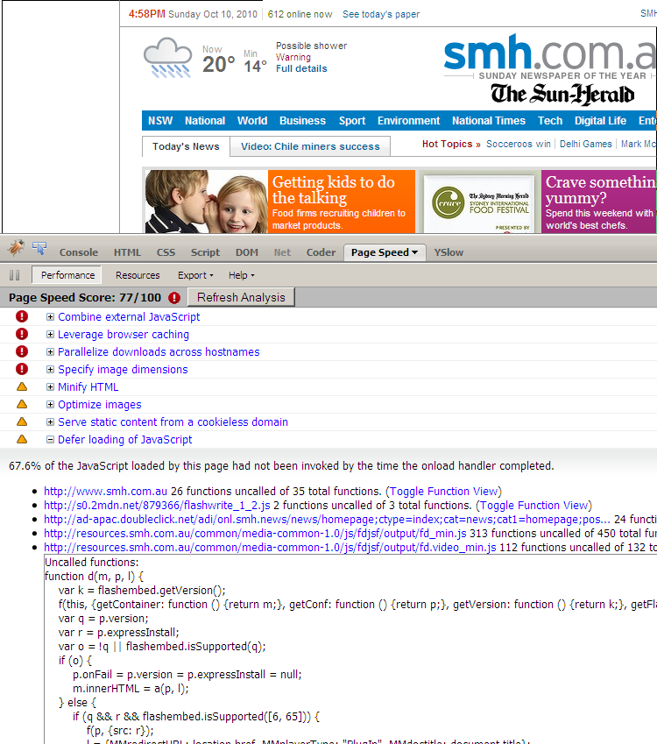
split the initial payload
split your JavaScript between what's needed to render the page and everything else
defer "everything else"
split manually (Page Speed), automatically (Microsoft Doloto)
load scripts without blocking
http://www.flickr.com/photos/devcentre/108032900/

Slide 23
Loading Scripts Without Blocking
XHR Eval
XHR Injection
Script in Iframe
Script DOM Element
Script Defer
document.write Script Tag
Notes:
All of these allow for parallel downloads, but none of them allow for parallel JS execution – that's not possible (currently, WebKit is doing some stuff on that).

Slide 24
XHR Eval
var xhrObj = getXHRObject();
xhrObj.onreadystatechange =
function() {
if ( xhrObj.readyState != 4 ) return;
eval(xhrObj.responseText);
};
xhrObj.open('GET', 'A.js', true);
xhrObj.send('');
script & page must be same domain

Slide 25
Script DOM Element
var se = document.createElement('script');
se.src = 'http://anydomain.com/A.js';
document.getElementsByTagName('head')
[0].appendChild(se);
script & page domains can differ
may not preserve execution order

Slide 26
Meebo Iframed JS
var iframe = document.createElement('iframe');
document.body.appendChild(iframe);
var doc = iframe.contentWindow.document;
doc.open().write('<body onload="insertJS()">');
doc.close();
loads asynchronously
delays parent’s load event: FF, Chr, Saf
great for 3rd party scripts
better for sandboxing & security
avoids iframe src roundtrip
Notes:
GMail Mobile: http://googlecode.blogspot.com/2009/09/gmail-for-mobile-html5-series-reducing.html
SproutCore: http://blog.sproutcore.com/post/225219087/faster-loading-through-eval

Slide 27
GMail Mobile
<script type="text/javascript">
/*
var ...
*/
</script>
get script DOM element's text
remove comments
eval() when invoked
inline or iframe
awesome for prefetching JS that might (not) be needed
Notes:
GMail Mobile: http://googlecode.blogspot.com/2009/09/gmail-for-mobile-html5-series-reducing.html
SproutCore: http://blog.sproutcore.com/post/225219087/faster-loading-through-eval

Slide 29
Google Search
window.setTimeout(
function(){
var a=document.createElement("script");
a.src="/extern_js/f/CgJlbhz8US8_w.js";
(document.getElementById("xjsd")||
document.body).appendChild(a);},
0);

Slide 30
Facebook
Bootloader.setResourceMap(
{"CDYbm":
{"name":"js\/32kskxvl4c8w0848.pkg.js",
"type":"js",
"src":"http:\/\/...\/1fakc64i.js"}, ...});
var c=a ? document.body : document.getElementsByTagName('head')[0];
var d=document.createElement('script');
d.type='text/javascript';
d.src=f;
c.appendChild(d);

Slide 31
Yahoo! FP
YUI.presentation.lazyScriptList =
["http://l.yimg.com/a/combo?arc/yui/substitute_0.1.9.js&arc/yui/oop_0.1.10.js&[...58 more!...]"];
d = w.document;
h = d.getElementsByTagName("head")[0];
n = d.createElement("script"),
n.src = url;
h.appendChild(n);

Slide 32
YouTube
<head>
...
<script src="http://s.ytimg.com/yt/jsbin/www-core-vfl1I8mph.jsA"></script>
...
</head>

Slide 33
Amazon
<body>
<div>
<table>
[~40%]
<script src="http://z-ecx.images-amazon.com/images/G/01/browser-scripts/us-site-wide-1.2.6/site-wide-4183309070.js._V198471533_.js"></script>

Slide 34
Craigslist
<script src="/js/jquery-1.4.2.js"></script>
</body>
</html>
subsequent page:
<script src="/js/jquery-1.4.2.js"></script>
<script src="/js/toChecklist.js"></script>
<script src="/js/tocs.js"></script>
</body>
</html>
prefetching?

Slide 35
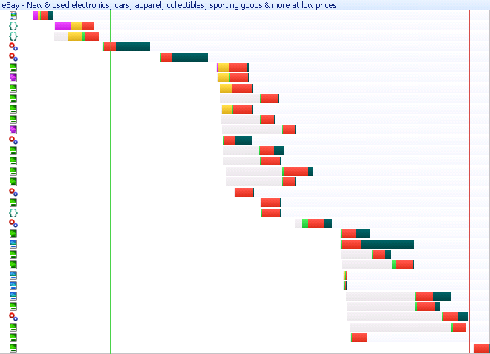
eBay
<body>
<script src="http://include.ebaystatic.com/v4js/en_US/e673/SYS-RA_vjo_e67311309442_1_en_US.js"></script>
<script src="http://include.ebaystatic.com/v4js/en_US/e673/GH-RA_ReskinEbay_e67311309442_1_en_US.js"></script>
...
<script src="http://include.ebaystatic.com/v4js/en_US/e673/SYS-RA_vjo_e67311252543_opta_en_US.js">
<script src="http://include.ebaystatic.com/v4js/en_US/e673/CCHP_HomepageV4_SLDR_e67311252543_6_en_US.js"></script>
</body>

Slide 36
(new)Twitter
$LAB
.wait(function() {
$LAB
.script("http://a1.twimg.com/a/1286563368/javascripts/phoenix.bundle.js")
.wait(function() {
...
});
$LAB
.script("http://a1.twimg.com/a/1286563368/javascripts/api.bundle.js")
.wait(function() {
...
});
});
http://labjs.com/

Slide 37
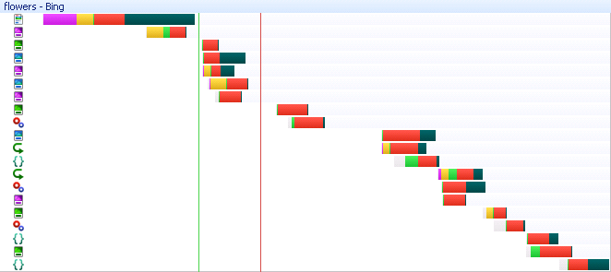
Bing
var a=_d.createElement("script");
a.type="text/javascript";
a.src=b;
_d.getElementsByTagName("head")[0].appendChild(a);
onload

Slide 38
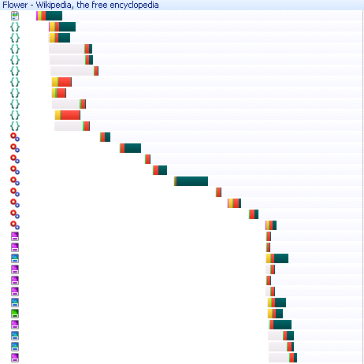
Wikipedia
<script src="http://bits.wikimedia.org/skins-1.5/common/wikibits.js?281c" type="text/javascript"></script>
<script src="http://bits.wikimedia.org/skins-1.5/common/jquery.min.js?281c" type="text/javascript"></script>
<script src="http://bits.wikimedia.org/skins-1.5/common/ajax.js?281c" type="text/javascript"></script>
<script src="http://bits.wikimedia.org/skins-1.5/common/mwsuggest.js?281c" type="text/javascript"></script>
<script src="http://bits.wikimedia.org/w/extensions/UsabilityInitiative/js/plugins.combined.min.js?281c" type="text/javascript"></script>
<script src="http://bits.wikimedia.org/w/extensions/UsabilityInitiative/Vector/Vector.combined.min.js?281c" type="text/javascript"></script>
<script src="http://upload.wikimedia.org/centralnotice/wikipedia/en/centralnotice.js?281c" type="text/javascript"></script>
<script src="/w/index.php?title=-&amp;action=raw&amp;gen=js&amp;useskin=vector&amp;281c" type="text/javascript"></script>
</head>

Slide 39
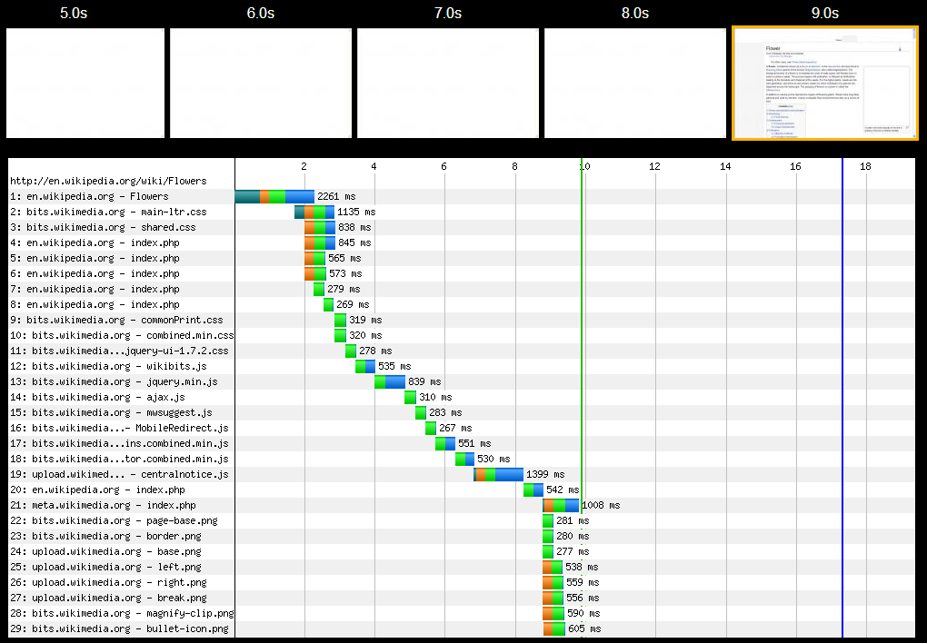
frontend SPOF
8.2 secs
http://en.wikipedia.org/wiki/Flowers (from NZ)
Notes:
http://www.webpagetest.org/result/100708_13X0/1/details/

Slide 40
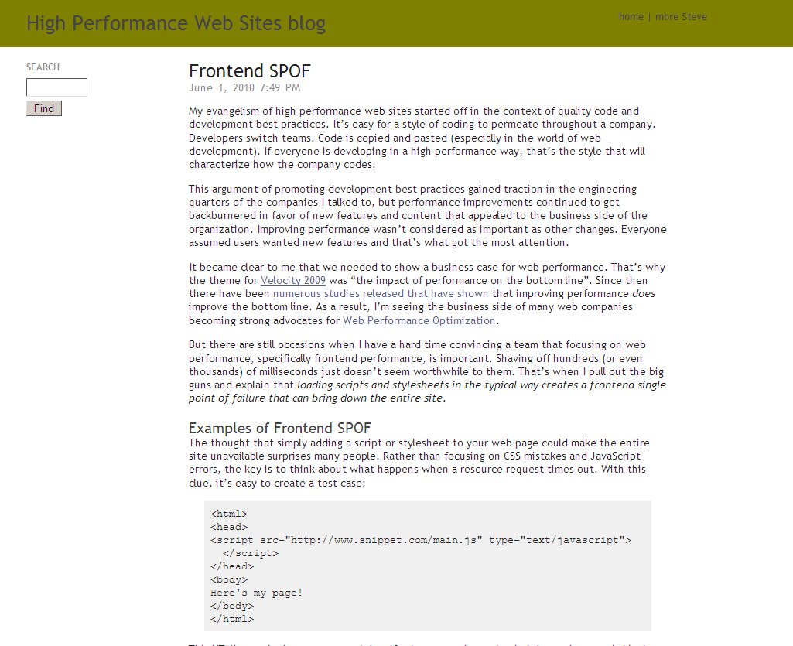
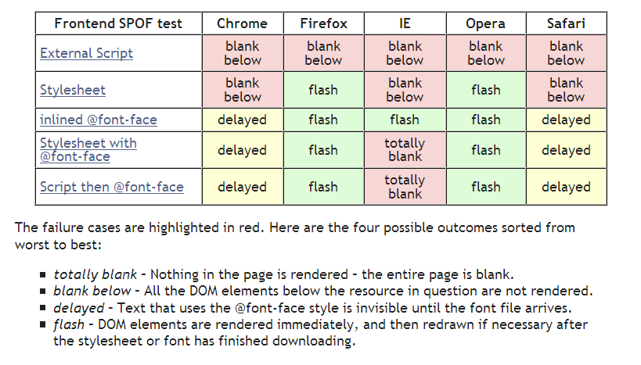

Slide 41
Evolution of Script Loading
scripts in HEAD
<head>
<script src=“…”></script>
</head>
block other downloads
downloaded sequentially in IE 6-7
blocks rendering during download & parse-execute

Slide 42
Evolution of Script Loading
move scripts to bottom (2007)
...
<script src=“…”></script>
</body>
doesn’t block other downloads
downloaded sequentially in IE 6-7
blocks rendering during download & parse-execute

Slide 43
Evolution of Script Loading
load scripts async (2009)
var se = document.createElement('script');
se.src = 'http://anydomain.com/A.js';
document.getElementsByTagName('head')
[0].appendChild(se);
doesn’t block other downloads
downloaded in parallel (all browsers)
blocks rendering during parse-execute

Slide 44
Evolution of Script Loading
async + on-demand exec (2010)
var se = new Image(); // or Object
se.onload = registerScript();
se.src = 'http://anydomain.com/A.js';
separate download from parse-execute
doesn’t block other download
downloaded in parallel (all browsers)
doesn’t block rendering until demanded
phpied.com/preload-cssjavascript-without-execution/

Slide 45
Evolution of Script Loading
2011
<link rel=“prefetch” href=“A.js”
onload=“registerScript()”>
doesn’t block other download
downloaded in parallel (all browsers)
doesn’t block rendering until demanded
easier

Slide 46
ControlJS a JavaScript module for making scripts load faster
control.js loads async
var cjsscript = document.createElement('script');
cjsscript.src = "control.js";
var cjssib = document.getElementsByTagName('script')[0];
cjssib.parentNode.insertBefore(cjsscript, cjssib);

Slide 47
ControlJS a JavaScript module for making scripts load faster
just change HTML
inline & external scripts
<script type="text/cjs" cjssrc="main.js">
<script>
<script type="text/cjs">
var name = getName();
<script>

Slide 48
ControlJS a JavaScript module for making scripts load faster
async downloads
delays execution
1st pass:
if (IE || Opera) { new Image(); }
else { document.createElement(‘object’); }
2nd pass:
external: document.createElement(‘script’);
inline: window.execScript(sCode) or window.eval.call(window, sCode)

Slide 49
ControlJS a JavaScript module for making scripts load faster
downloads w/ no execution
<script type="text/cjs" cjssrc="main.js“ cjsexec=false>
<script>
later (if needed):
CJS.execScript(src);

Slide 50
ControlJS a JavaScript module for making scripts load faster
handles (some) document.write
override document.write for each script
set SPAN innerHTML if there’s a write
parse out SCRIPT tags & add SCRIPT elem
better solutions:
Aptimize – http://www.aptimize.com/
GhostWriter – http://digital-fulcrum.com/solutions /ghostwriter-complete-control/

Slide 51
ControlJS a JavaScript module for making scripts load faster
control.js loads async
just change HTML
inline & external scripts
async downloads
delays execution
downloads w/ no execution
handles (some) document.write

Slide 52
ControlJS a JavaScript module for making scripts load faster
http://stevesouders.com/controljs/
http://code.google.com/p/controljs/
http://groups.google.com/group/controljs

Slide 53
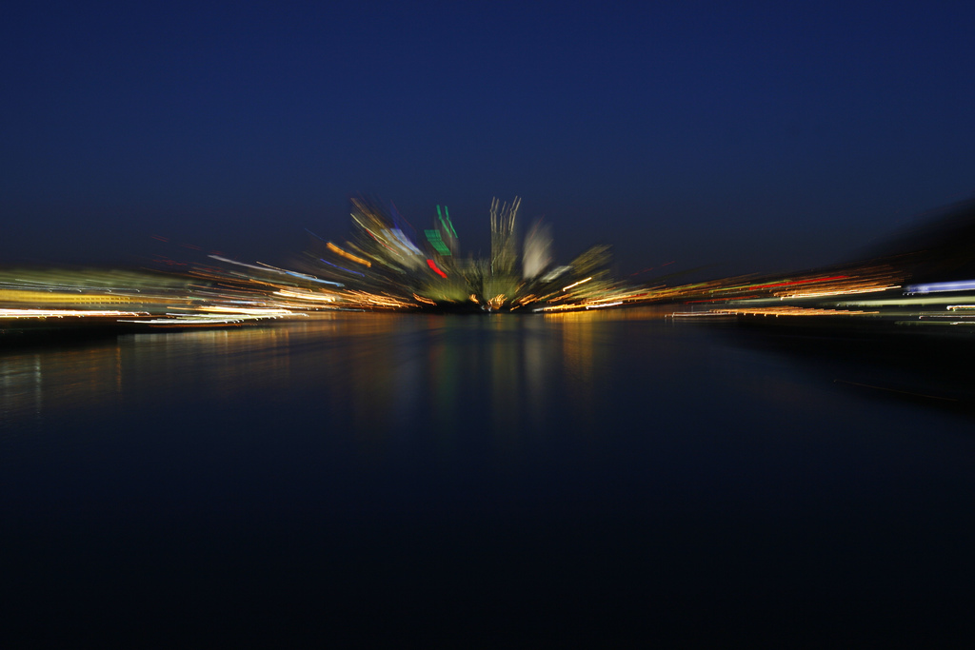
takeaways
speed matters
focus on the frontend
progressive enhancement  progressive rendering
try ControlJS
flickr.com/photos/34771728@N00/361526991/

Slide 54
Steve Souders
@souders
stevesouders.com/docs/thinkvitamin-20101216.pptx
flickr.com/photos/myklroventine/4062102754/
Notes:
http://www.flickr.com/photos/myklroventine/4062102754/

