Slide 1
Web
Performance
Optimization
WPO
stevesouders.com/docs/web20expo-20100505.pptx
slideshare.net/souders/souders-wpo-web20expo
Disclaimer: This content does not necessarily reflect the opinions of my employer.
flickr.com/photos/mubashir/2616724942/

Slide 2
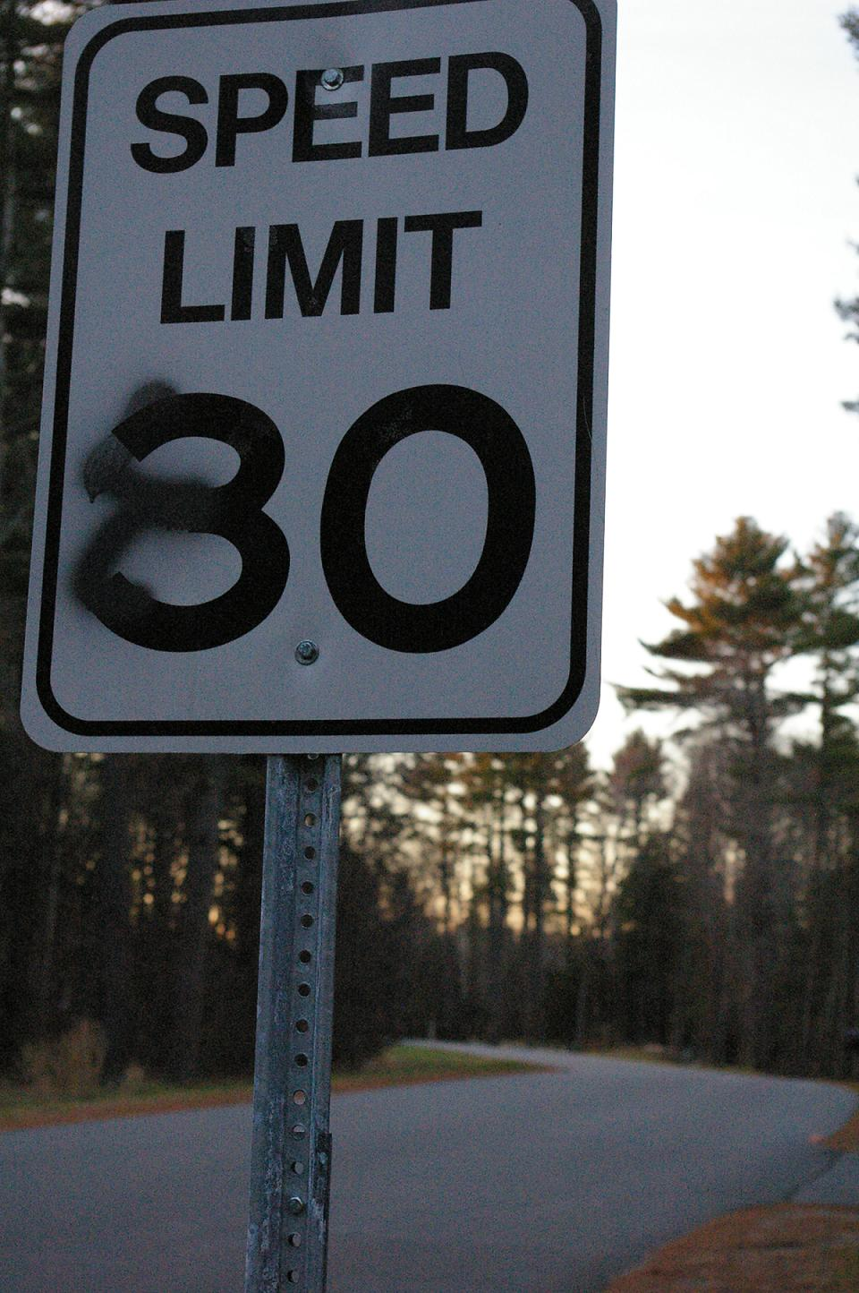
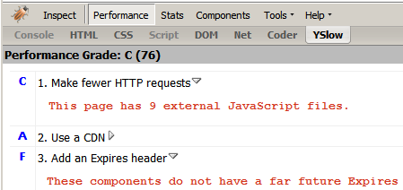
flickr.com/photos/bekahstargazing/318930460/

Slide 3
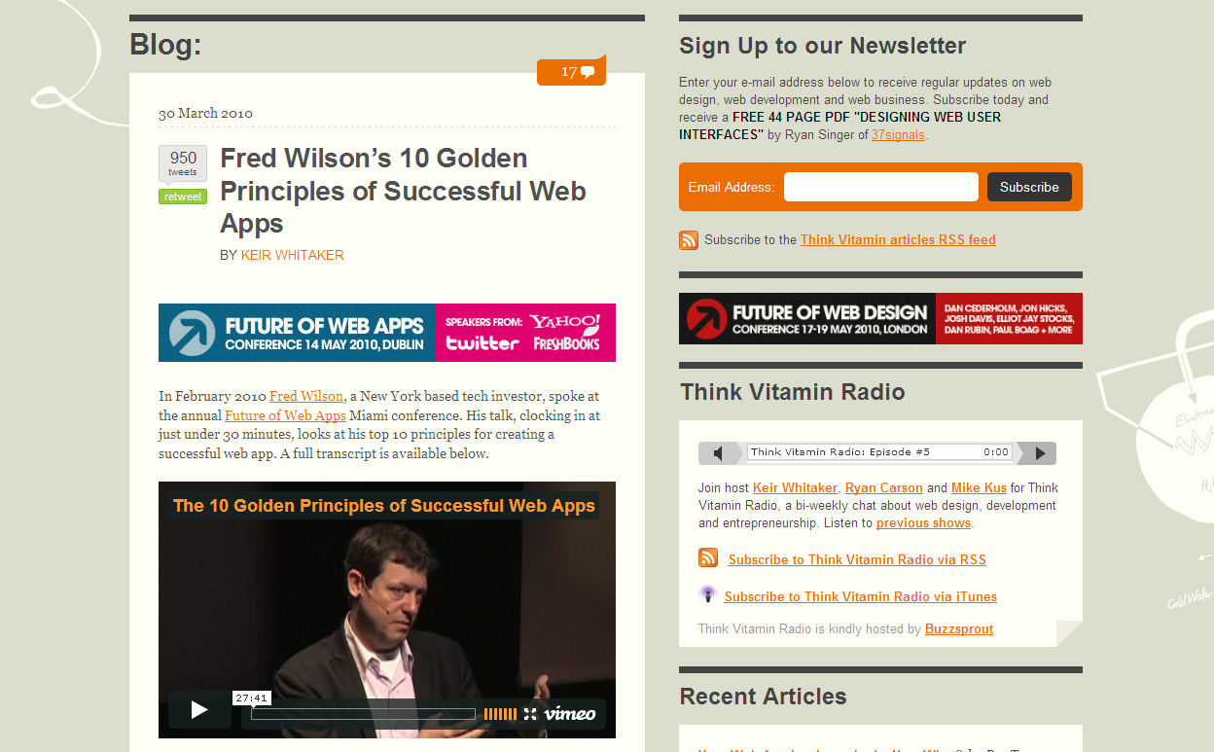
carsonified.com/blog/business/fred-wilsons-10-golden-principles-of-successful-web-apps/
1. Speed - First and foremost, we believe that speed is more than a feature. Speed is the most important feature.
Notes:
Fred Wilson is Managing Partner of two venture capital firms, Flatiron Partners (Yoyodyne, Geocities) and Union Square Ventures (Twitter, delicious, Etsy, Feedburner).
Speed
Instant utility
Software is media
Less is more
Make it programmable
Make it personal
RESTful
Discoverability
Clean
Playful

Slide 4
en.oreilly.com/velocity2009/public/schedule/detail/8523

Slide 5
en.oreilly.com/velocity2009/public/schedule/detail/8523

Slide 6
Yahoo!
0.4 sec slower
traffic ⬇ 5-9%
slideshare.net/stoyan/dont-make-me-wait-or-building-highperformance-web-applications
slideshare.net/stoyan/yslow-20-presentation

Slide 7
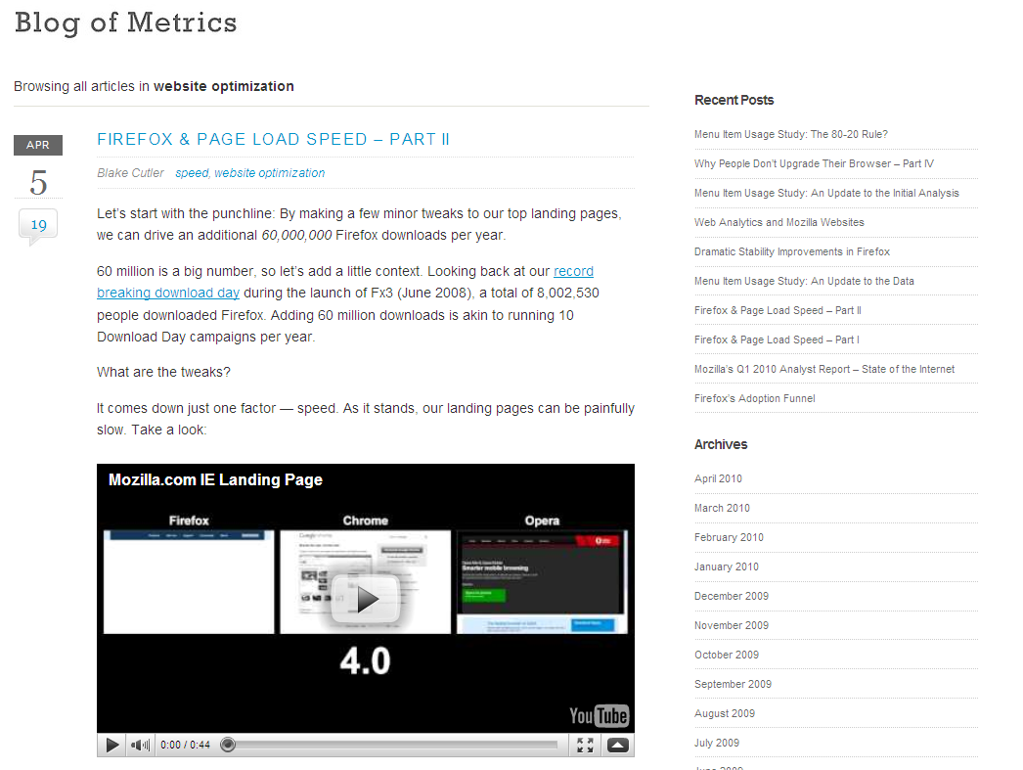
blog.mozilla.com/metrics/category/website-optimization/
…shaved 2.2 seconds off the average page load time and increased download conversions by 15.4%!
Notes:
“if we’re able to achieve a similar performance boost across our other top landing pages, we’ll drive in excess of 60 million yearly Firefox downloads.”

Slide 8
en.oreilly.com/velocity2009/public/schedule/detail/7709
blog.mozilla.com/metrics/category/website-optimization/
…shaved 2.2 seconds off the average page load time and increased download conversions by 15.4%!
Notes:
This was a ~5 second speed up.

Slide 9
en.oreilly.com/velocity2008/public/schedule/detail/3632

Slide 10
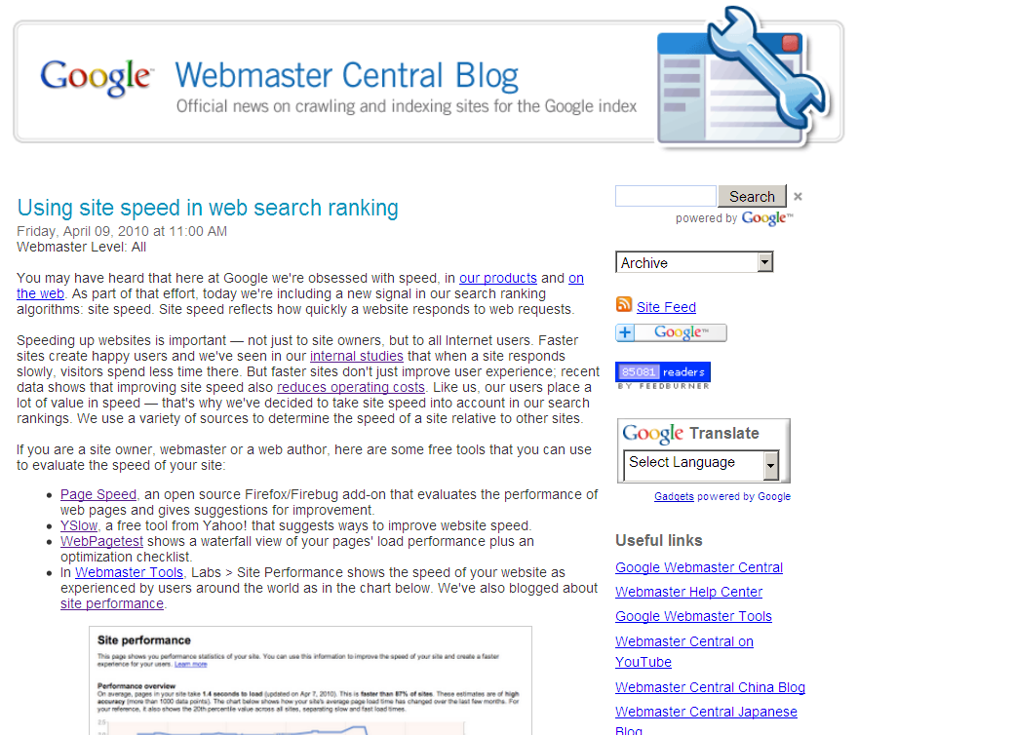
Site speed in search rank
…we've decided to take site speed into account in our search rankings.
Screen shot of blog post
googlewebmastercentral.blogspot.com/2010/04/using-site-speed-in-web-search-ranking.html
Notes:
Time measurements from real users.

Slide 11
Web
Performance
Optimization
WPO
drives traffic
improves UX
increases revenue
reduces costs
flickr.com/photos/pedromourapinheiro/3123885534/

Slide 12
top 10 WPO predictions
#10: fast-by-default
CMSs
PHP, Rails, Python
cloud – AWS, GAE
JS libraries
browsers, servers, proxies
flickr.com/photos/eole/380316678/

Slide 13
top 10 WPO predictions
#9: visibility into the browser
JS, CSS, paint, DOM
dynaTrace
Speed Tracer
flickr.com/photos/eole/380316678/

Slide 14
top 10 WPO predictions
#8: consolidation
tools
metrics
services
flickr.com/photos/eole/380316678/

Slide 15
top 10 WPO predictions
#7: TCP, HTTP
SPDY
pipelining
resource packages
flickr.com/photos/eole/380316678/

Slide 16
top 10 WPO predictions
#6: standards
terminology
timing
benchmarks
testing
flickr.com/photos/eole/380316678/

Slide 17
top 10 WPO predictions
#5: industry organizations
professional groups
training, certification
standards bodies
cooperatives
flickr.com/photos/eole/380316678/
Notes:
coops – similar to anti-spam coop, imagine Google Ajax Libraries API also supported on AWS,

Slide 18
top 10 WPO predictions
#4: data
Internet Performance Archive
network parameters
DNS
cache
flickr.com/photos/eole/380316678/

Slide 19
top 10 WPO predictions
#3: green
Shopzilla – half the servers
Netflix – half the bandwidth
power consumption
carbon footprint
flickr.com/photos/eole/380316678/

Slide 20
top 10 WPO predictions
#2: mobile
metrics
long poles
root causes
solutions, best practices
tools, automation
evangelism, case studies
flickr.com/photos/eole/380316678/

Slide 21
top 10 WPO predictions
#1: speed’s a differentiator
devices
vendor selection
reviews
user loyalty
flickr.com/photos/eole/380316678/

Slide 22
top 10 WPO predictions
10. fast-by-default
9. visibility into the browser
8. consolidation
7. TCP, HTTP
6. standards
5. industry organizations
4. data
3. green
2. mobile
1. speed’s a differentiator
flickr.com/photos/eole/380316678/

Slide 23
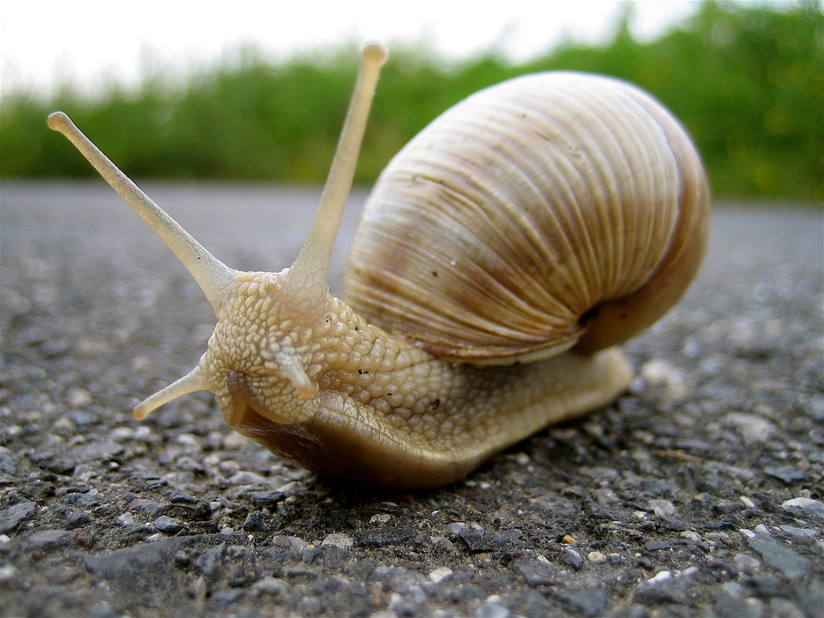
P3PC
Performance of 3rd Party Content
Ads
Widgets
Analytics
flickr.com/photos/ntr23/729463293/

Slide 24
performance badness
opportunities
main page
2005
2010
3rd party content

Slide 25
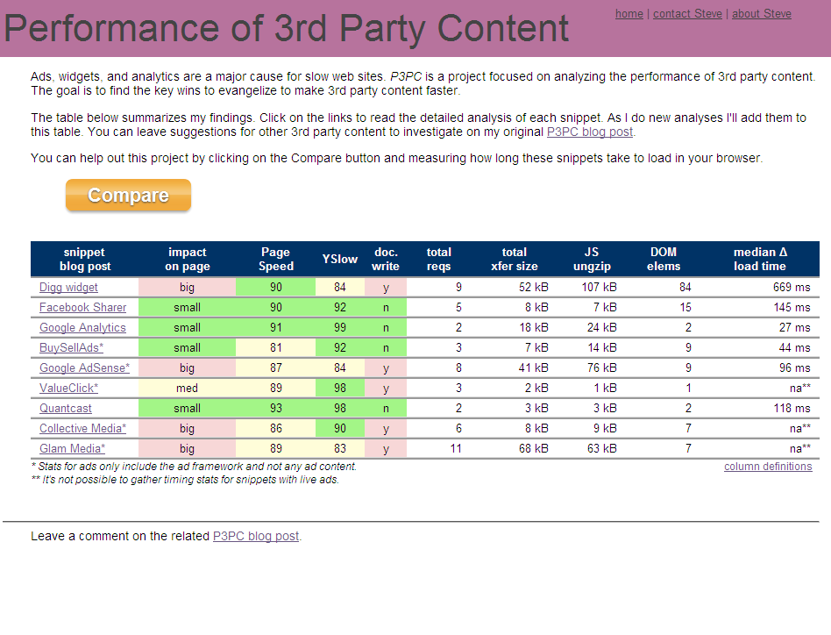
stevesouders.com/p3pc/

Slide 26
appendChild or insertBefore?
document.getElementsByTagName('head‘)[0] .appendChild(domscript);
document.documentElement.firstChild .appendChild(ga);
s = document.getElementsByTagName ('script')[0];
s.parentNode.insertBefore(ga, s);
- Souders (May 2008)
- Google Analytics (Dec 2009)
- Google Analytics (Feb 2010)
flickr.com/photos/amodiovalerioverde/425333516/

Slide 27
appendChild or insertBefore?
if (q.insertBefore) {
var s = _get(q.insertBefore, id);
if (s) {
s.parentNode.insertBefore(n, s);
}
} else {
h.appendChild(n);
}
- YUI Loader 2.6.0 (2008)
flickr.com/photos/amodiovalerioverde/425333516/

Slide 28
appendChild or insertBefore?
b = this.getHardpoint();
f = document.createElement('script');
f.src = g;
f.type = 'text/javascript';
f.async = true;
b.appendChild(f);
getHardpoint: function() {
var c, b = document.getElementsByTagName('head');
if (b.length) { c = b[0]; }
else c = document.body;
this._hardpoint = c;
}
- Facebook (April 18, 2010)
flickr.com/photos/amodiovalerioverde/425333516/

Slide 29
appendChild or insertBefore?
head = document.getElementsByTagName ("head")[0] || document.documentElement;
// Use insertBefore instead of appendChild to circumvent an IE6 bug.
// This arises when a base node is used (#2709 and #4378).
head.insertBefore(script, head.firstChild);
- jQuery
flickr.com/photos/amodiovalerioverde/425333516/

Slide 30
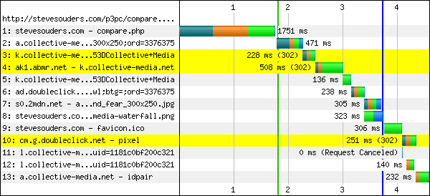
appendChild or insertBefore?
var f=document.getElementsByTagName("script");
var b=f[f.length-1]; // b is last script tag
if(b==null){ return; }
var i=document.createElement("script");
i.language="javascript"; // i is a script element
i.setAttribute("type","text/javascript");
var j=""; // j is a string
j+="document.write('<scr'+'ipt language=\"javascript\" src=\""+c+"\"></scr'+'ipt>');";
var g=document.createTextNode(j); // not used
b.parentNode.insertBefore(i,b);
appendChild(i,j);
function appendChild(a,b){
if(null==a.canHaveChildren||a.canHaveChildren){
a.appendChild(document.createTextNode(b));
}
else{ a.text=b;}
}
- Collective Media
flickr.com/photos/amodiovalerioverde/425333516/

Slide 31
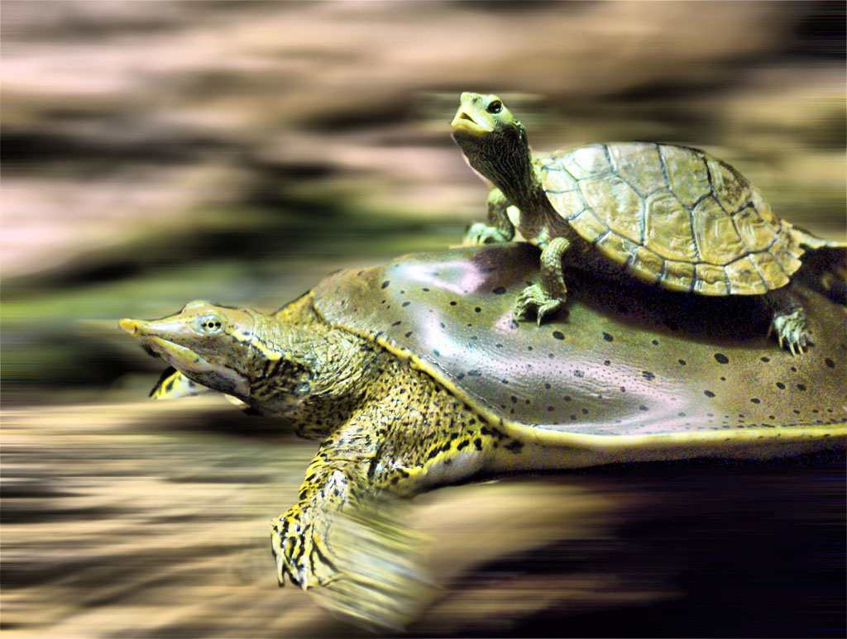
“Frag Tag”
Alex Russell
snippet
<FRAG>
<script src=“snippet.js”></script>
</FRAG>
doesn’t block rendering
async document.write
JavaScript sandboxing
just a twinkle in my eye
frag tag
flickr.com/photos/bestrated1/2141687384/

Slide 32
browser wishlist
stevesouders.com/blog/2010/02/15/browser-performance-wishlist/
Frag tag
SPDY
non-blocking scripts
SCRIPT attributes
resource packages
border-radius
cache redirects
link prefetch
Web Timing spec
remote JS debugging
web sockets
History
progressive XHR
anchor ping
stylesheet, inline js
inline script defer
@import
@font-face
stylesheets,iframes
paint events
missing schema
flickr.com/photos/eole/380316678/

Slide 33
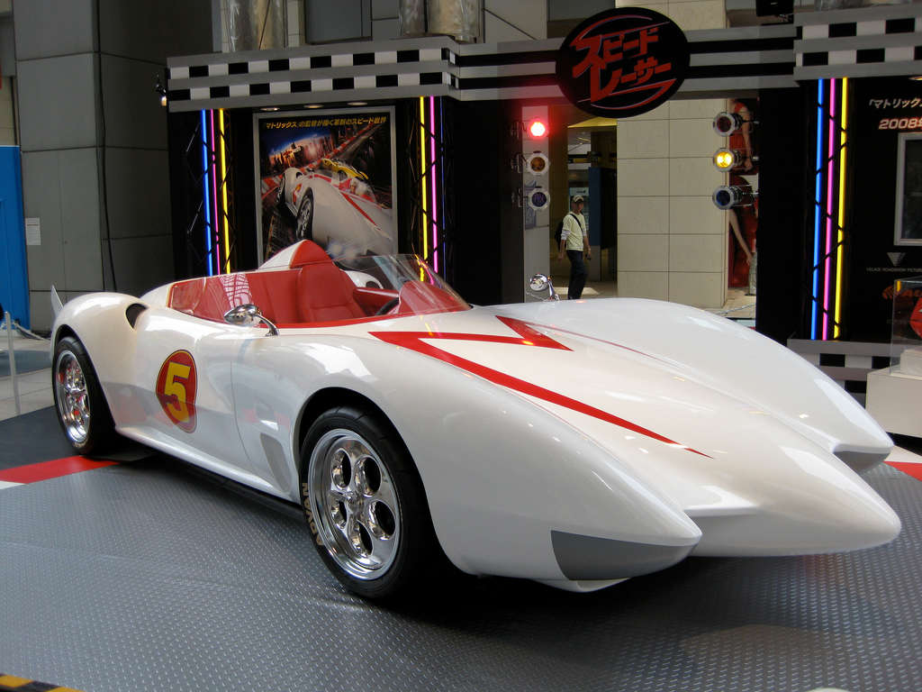
browser disk cache
default size is too small
IE: 8-50M
Firefox: 50M
Chrome: < 80M
Opera: 20M
eviction algorithm improvements
content-type: script > image
past impact: 1000 ms > 100 ms
preferred sites
stevesouders.com/cache.php
flickr.com/photos/minami/2458184654/

Slide 34
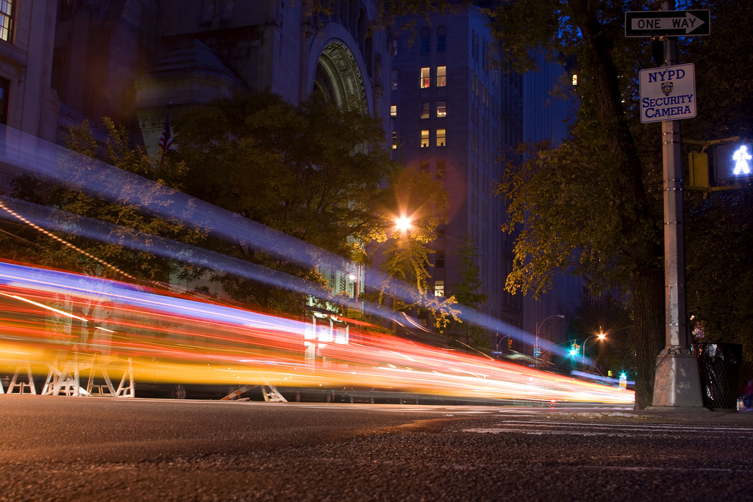
news
flickr.com/photos/motionblur/3049984012/

Slide 35
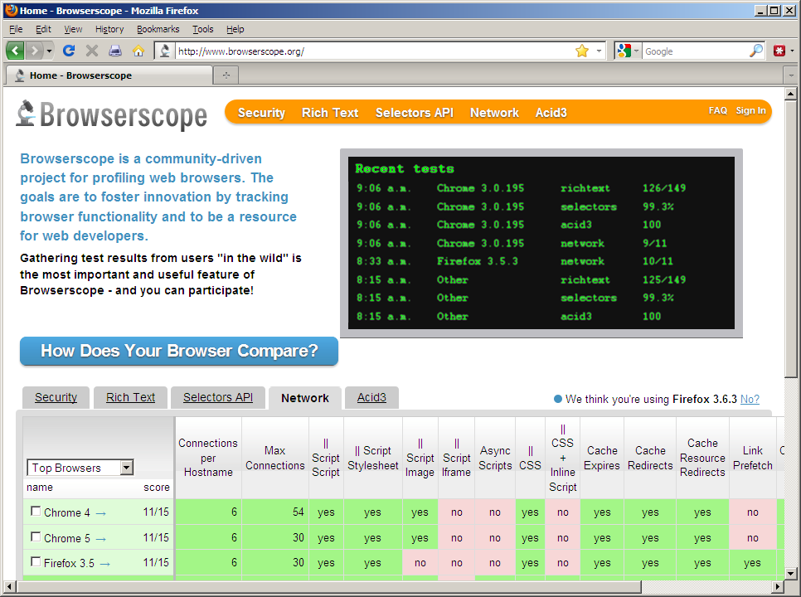
Browserscope

Slide 36
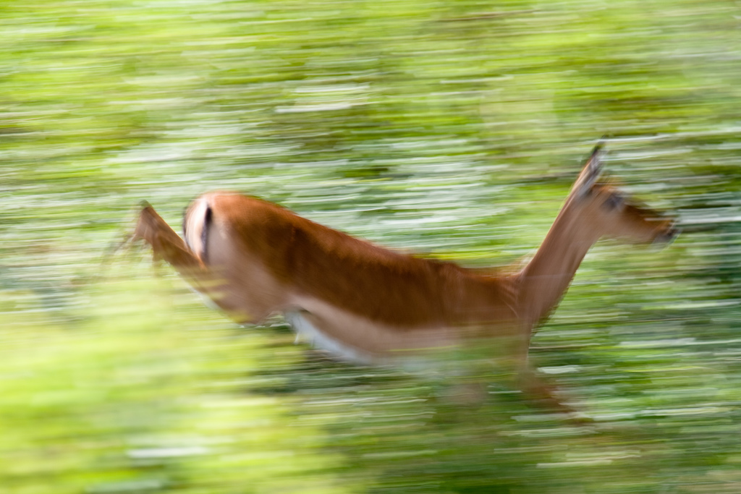
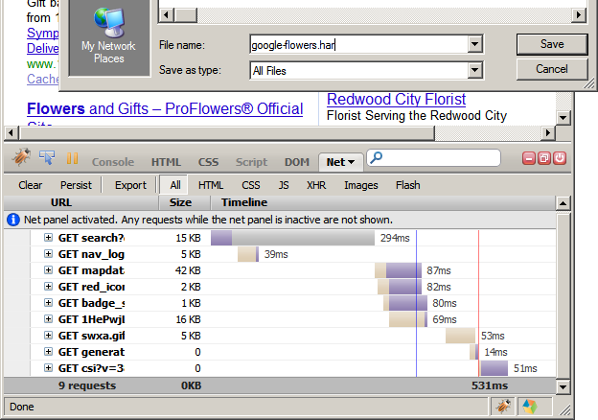
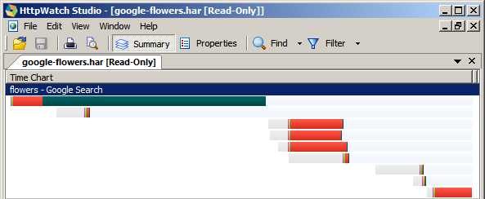
HTTP Archive Format
(HAR)
flickr.com/photos/duncanfawkes/2585929403/
Notes:
http://stevesouders.com/blog/2009/10/19/http-archive-specification-firebug-and-httpwatch/

Slide 37
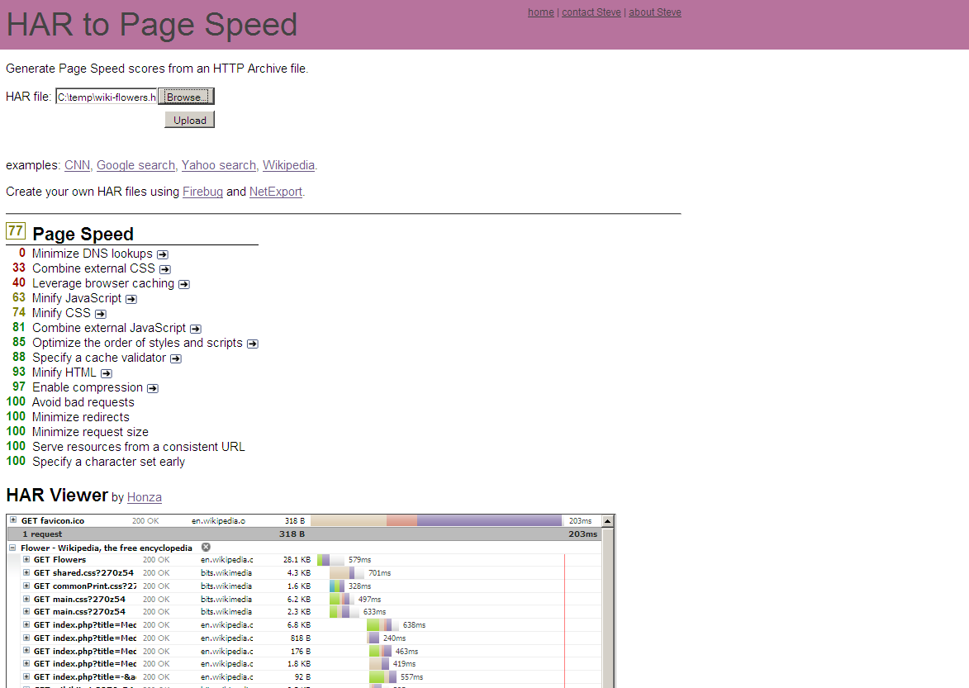
stevesouders.com/flint/

Slide 38
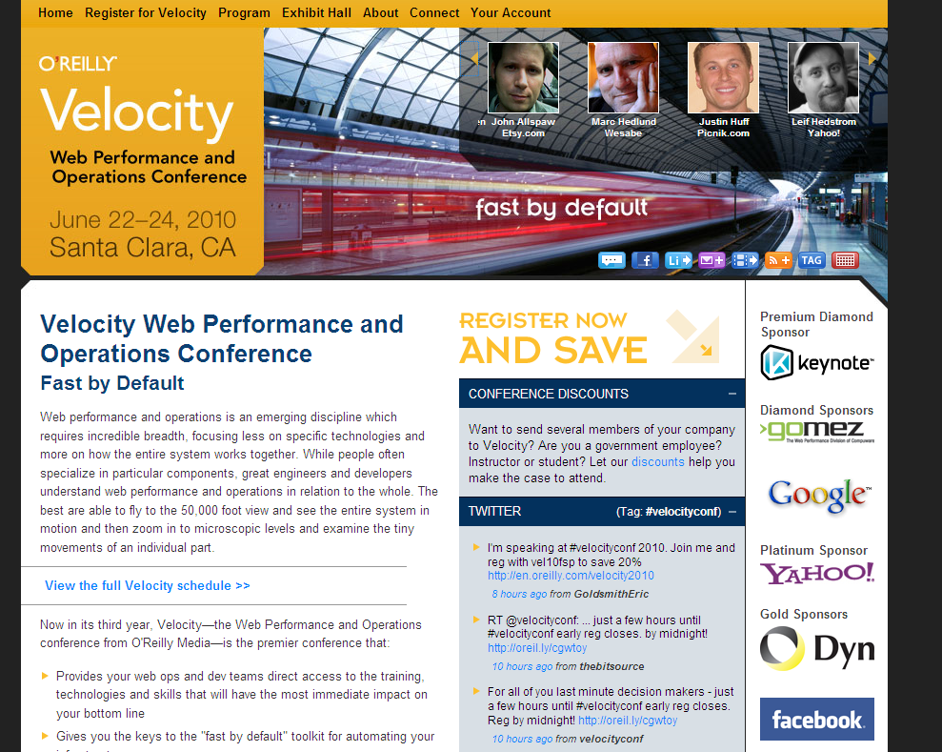

Slide 39
Site speed in search rank
Screen shot of blog post
googlewebmastercentral.blogspot.com/2010/04/using-site-speed-in-web-search-ranking.html
Notes:
Time measurements from real users.

Slide 40
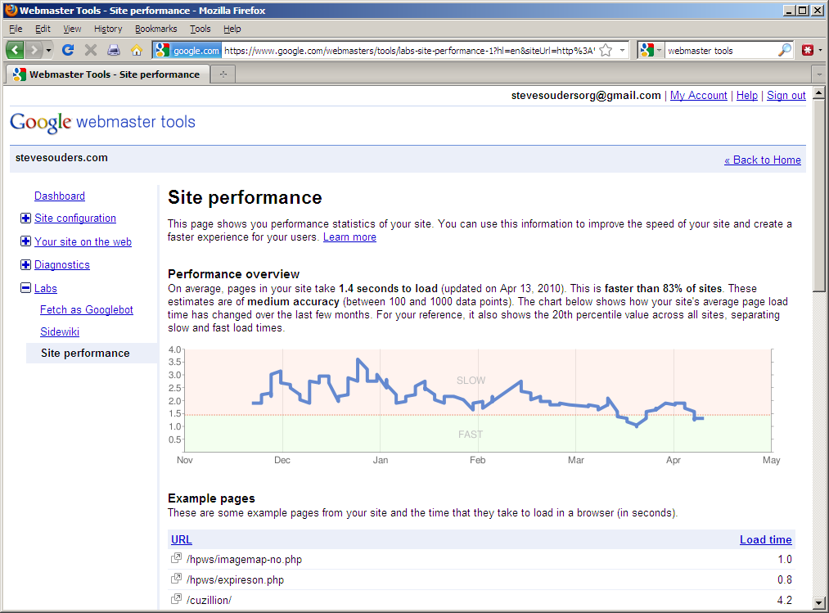

Slide 41
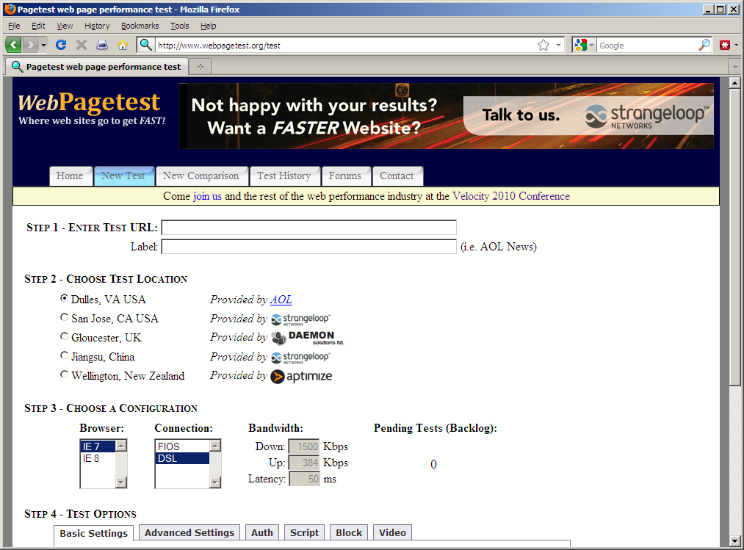

Slide 42
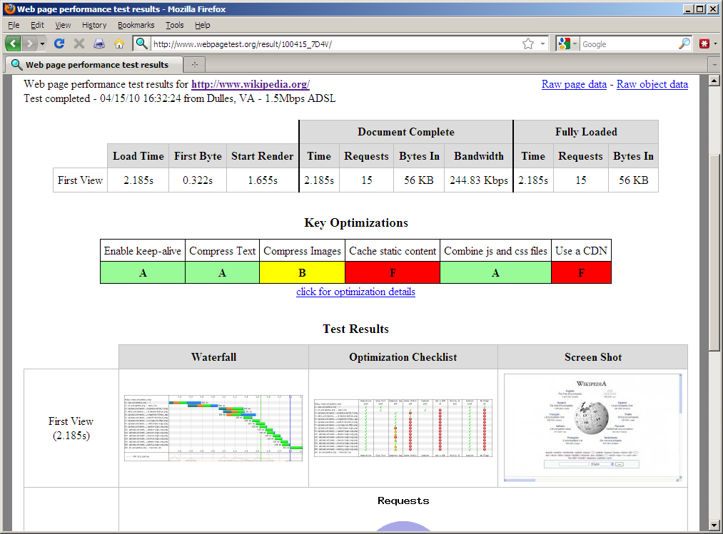

Slide 43
Both
combine scripts
combine stylesheets
add an Expires header
gzip responses
put stylesheets at the top
put scripts at the bottom
avoid CSS expressions
make JS and CSS external
reduce DNS lookups
minify JS and CSS
avoid redirects
remove duplicate scripts
make Ajax cacheable
reduce cookie size
use cookie-free domains
don't scale images
YSlow
use CSS sprites
use a CDN
configure ETags
use GET for Ajax requests
reduce # of DOM elements
no 404s
avoid image filters
optimize favicon
Page Speed
defer loading JS
remove unused CSS
use efficient CSS selectors
optimize images
optimize order of CSS & JS
shard domains
leverage proxy caching

Slide 44
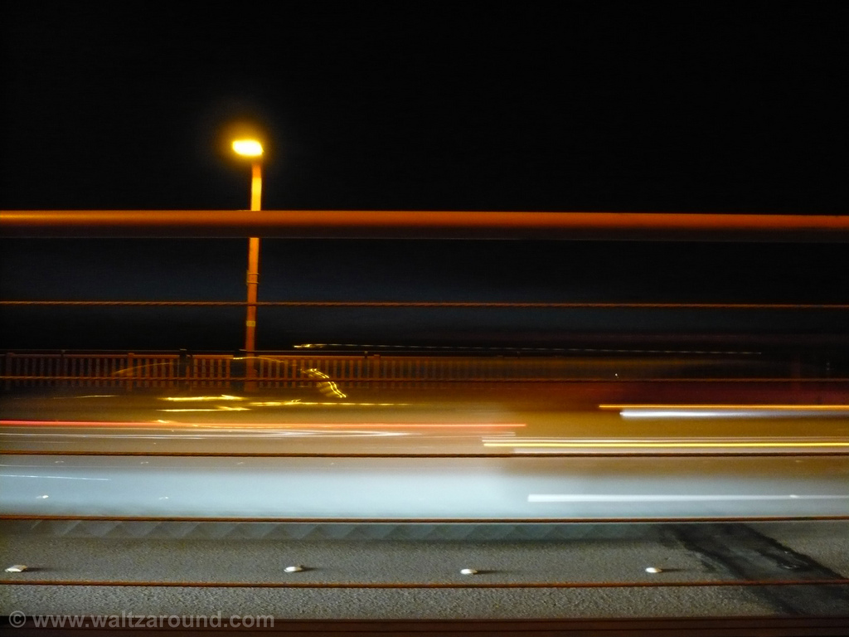
Jenn Lukas
Happy Cog
Ray Morgan
Zappos.com
Makinde Adeagbo
Facebook
http://www.flickr.com/photos/waltzaround/4041024134/

Slide 45
takeaways
speed matters
a lot is coming in WPO
guard against 3rd party content
stevesouders.com/cache.php
flickr.com/photos/34771728@N00/361526991/

Slide 46
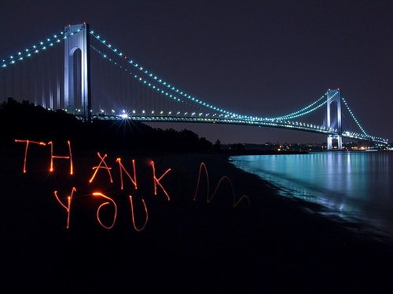
Steve Souders
@souders, souders@google.com
stevesouders.com/docs/web20expo-20100505.pptx
flickr.com/photos/nj_dodge/187190601/

Slide 47
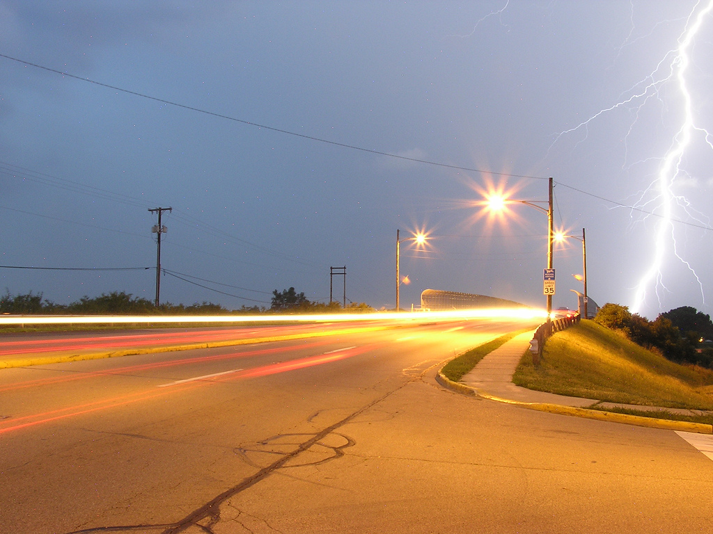
flickr.com/photos/ddfic/722634166/

Slide 48
flickr.com/photos/lrargerich/3115367361/
Notes:
YtseJam Photography, "Going nowhere fast", http://www.flickr.com/photos/thatguyfromcchs08/2300190277/

