Slide 1
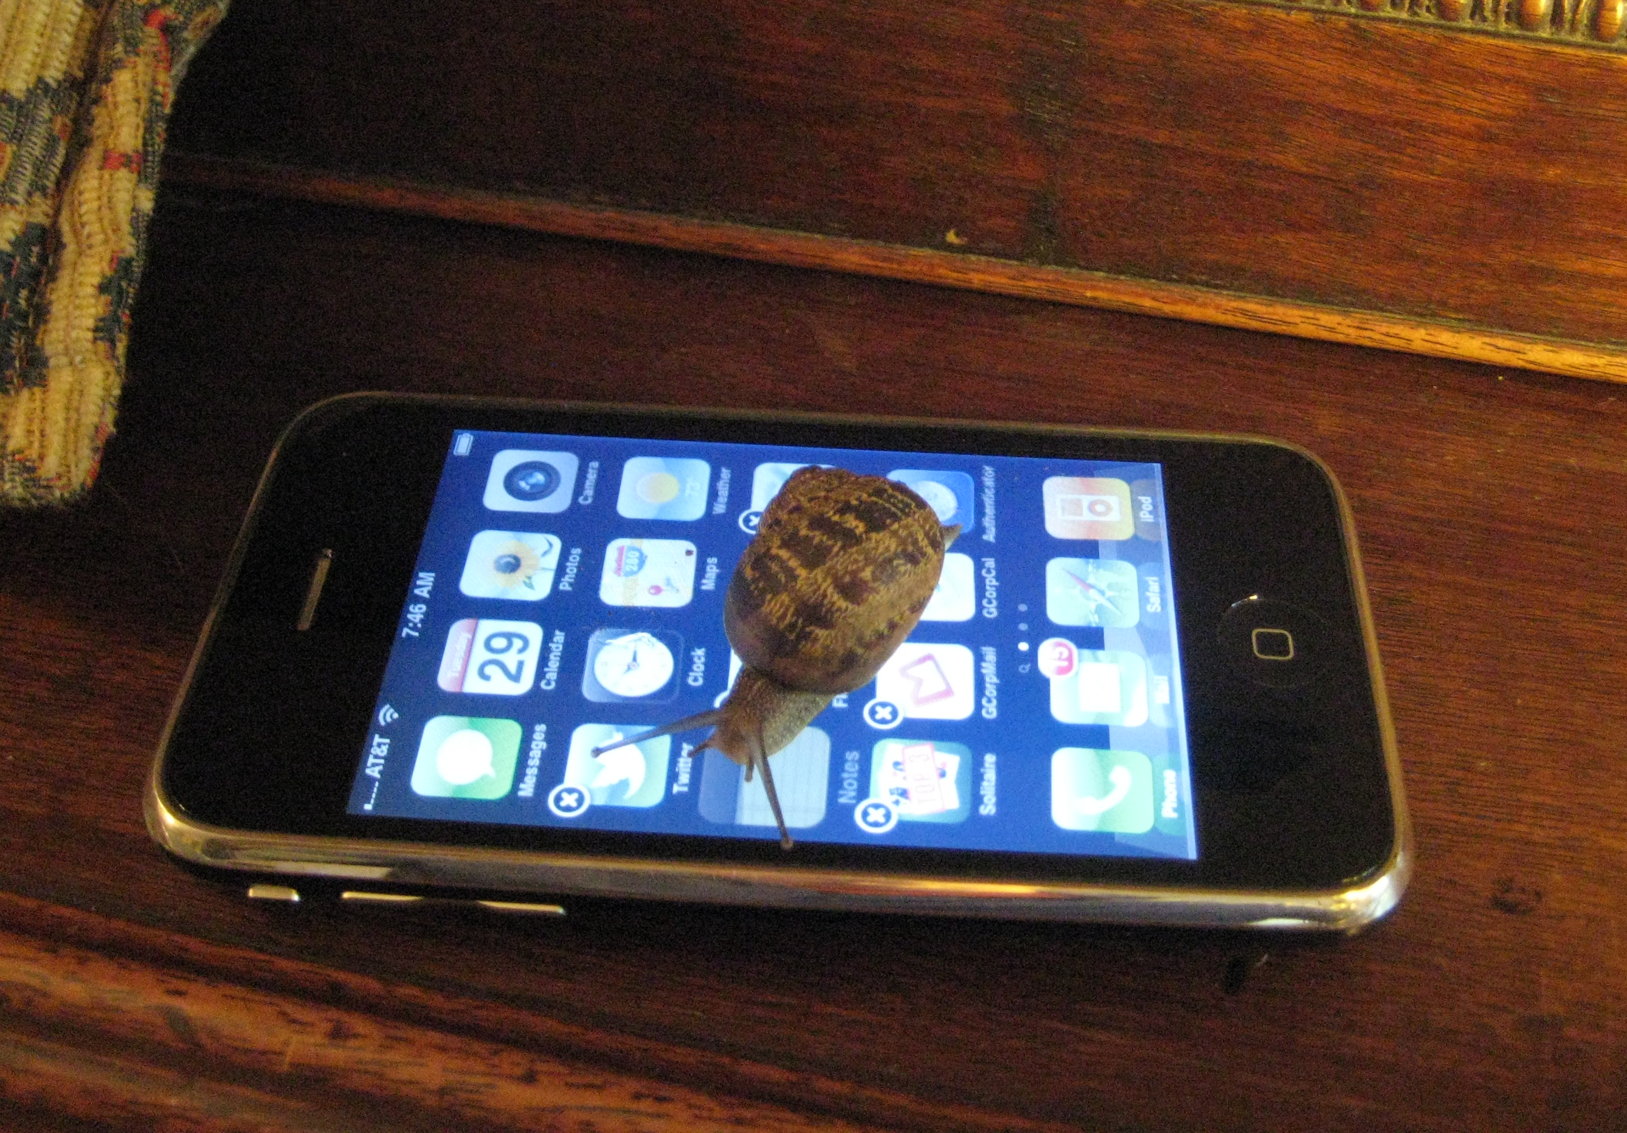
High Performance Mobile
stevesouders.com/docs/web20expo-20110330.pptx
Disclaimer: This content does not necessarily reflect the opinions of my employer.

Slide 2
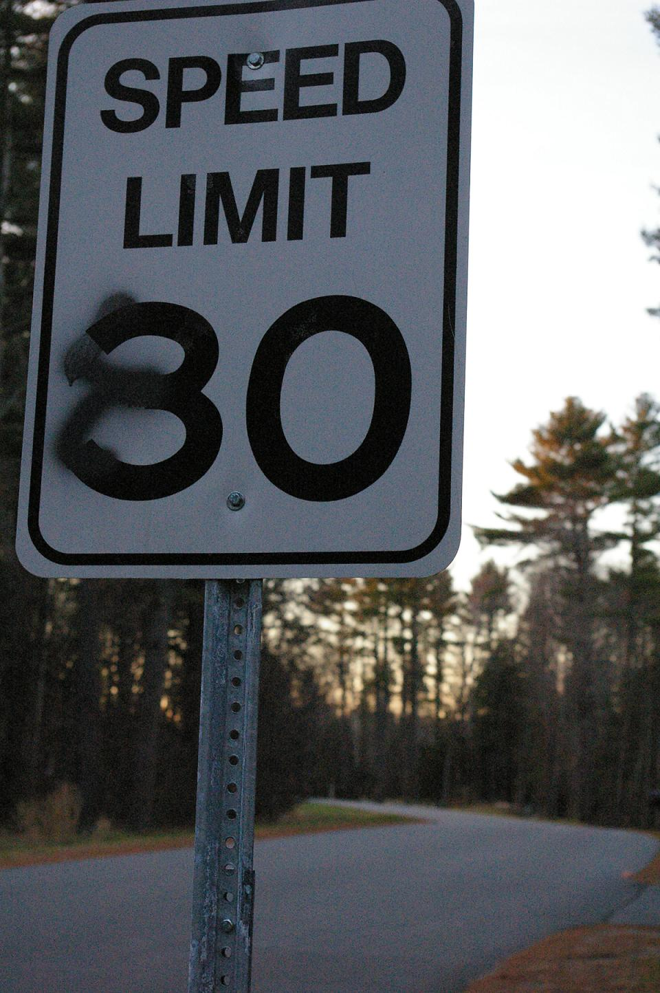
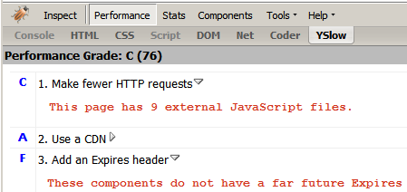
flickr.com/photos/bekahstargazing/318930460/

Slide 3
2004

Slide 4
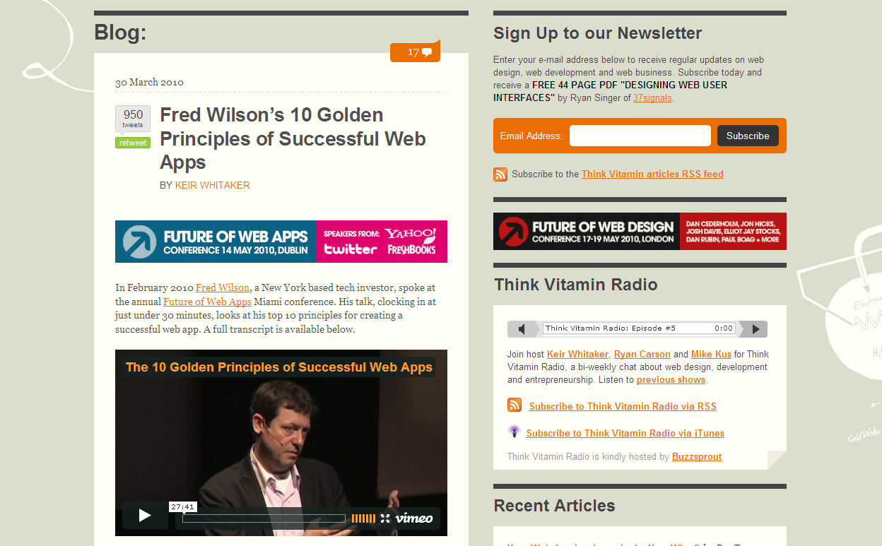
carsonified.com/blog/business/fred-wilsons-10-golden-principles-of-successful-web-apps/
#1. Speed: “First and foremost, we believe that speed is more than a feature. Speed is the most important feature.”
Notes:
Fred Wilson is Managing Partner of two venture capital firms, Flatiron Partners (Yoyodyne, Geocities) and Union Square Ventures (Twitter, delicious, Etsy, Feedburner).
Speed
Instant utility
Software is media
Less is more
Make it programmable
Make it personal
RESTful
Discoverability
Clean
Playful

Slide 5
en.oreilly.com/velocity2009/public/schedule/detail/8523

Slide 6
en.oreilly.com/velocity2009/public/schedule/detail/8523

Slide 7
Yahoo!
0.4 sec slower
traffic ⬇ 5-9%
slideshare.net/stoyan/dont-make-me-wait-or-building-highperformance-web-applications
slideshare.net/stoyan/yslow-20-presentation

Slide 8
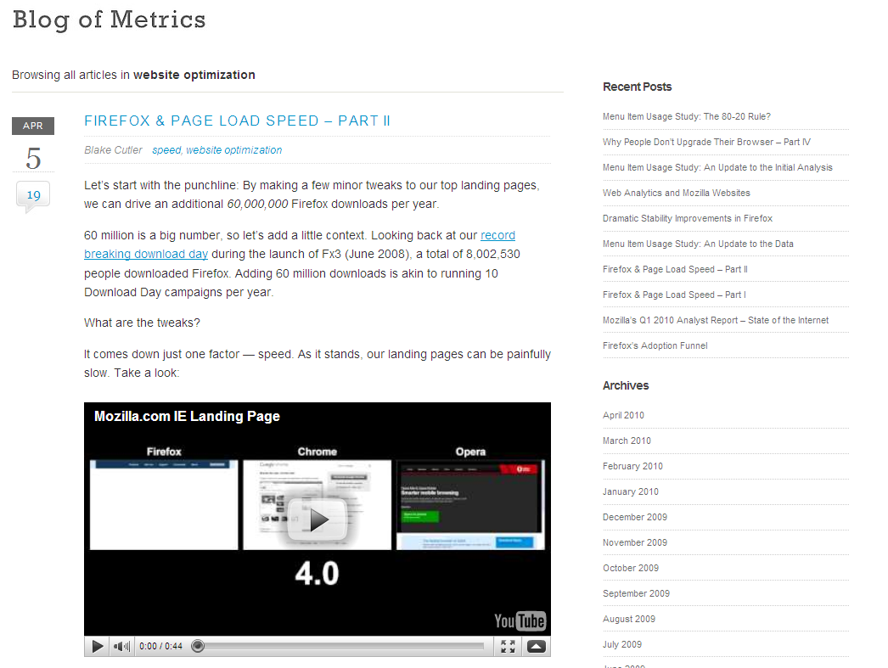
blog.mozilla.com/metrics/category/website-optimization/
…shaved 2.2 seconds off the average page load time and increased download conversions by 15.4%!
Notes:
“if we’re able to achieve a similar performance boost across our other top landing pages, we’ll drive in excess of 60 million yearly Firefox downloads.”

Slide 9
en.oreilly.com/velocity2009/public/schedule/detail/7709
blog.mozilla.com/metrics/category/website-optimization/
…shaved 2.2 seconds off the average page load time and increased download conversions by 15.4%!
Notes:
This was a ~5 second speed up.

Slide 10
en.oreilly.com/velocity2008/public/schedule/detail/3632

Slide 11
slideshare.net/EdmundsLabs/how-edmunds-got-in-the-fast-lane-80-reduction-in-page-load-time-in-3-simple-steps-6593377

Slide 12
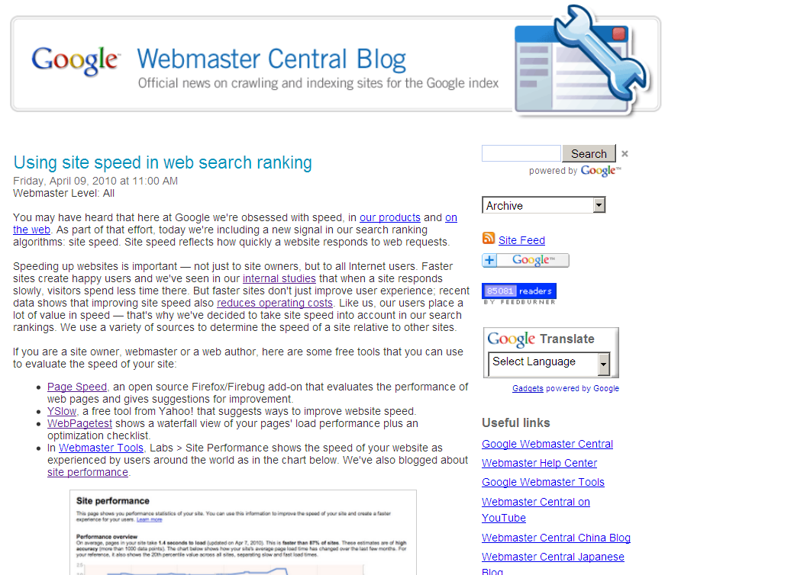
Site speed in search rank
…we've decided to take site speed into account in our search rankings.
Screen shot of blog post
googlewebmastercentral.blogspot.com/2010/04/using-site-speed-in-web-search-ranking.html
Notes:
Time measurements from real users.

Slide 13
Web
Performance
Optimization
WPO
drives traffic
improves UX
increases revenue
reduces costs
flickr.com/photos/pedromourapinheiro/3123885534/

Slide 14
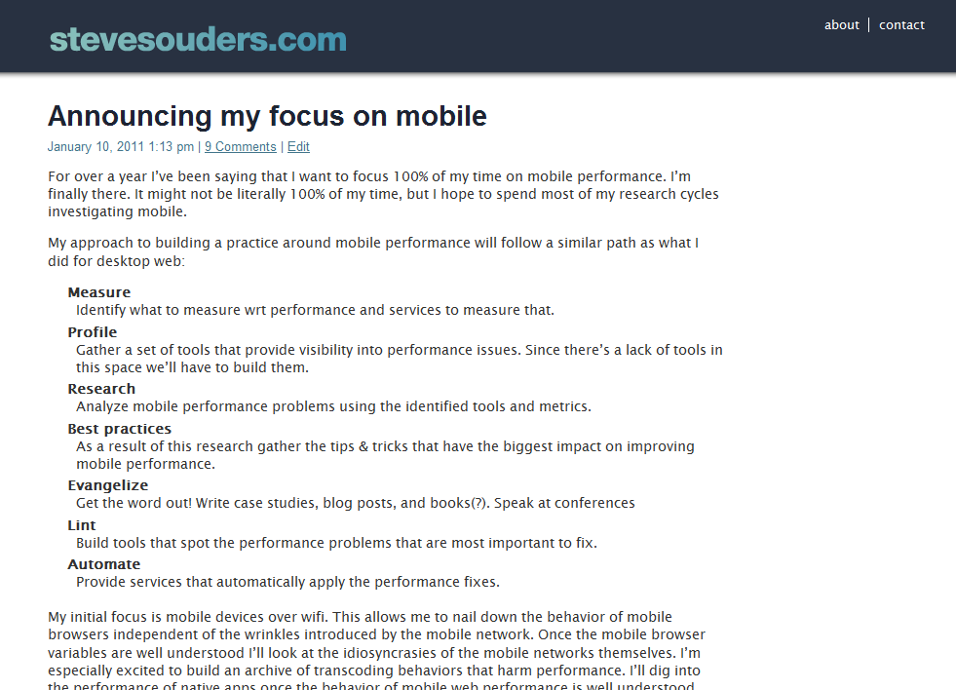

Slide 15
slideshare.net/CMSummit/ms-internet-trends060710final

Slide 16
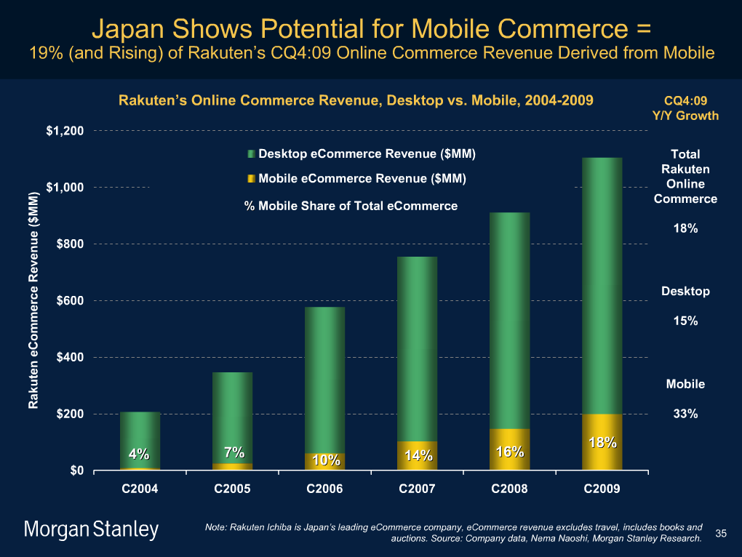
slideshare.net/CMSummit/ms-internet-trends060710final

Slide 17
slideshare.net/CMSummit/ms-internet-trends060710final

Slide 18
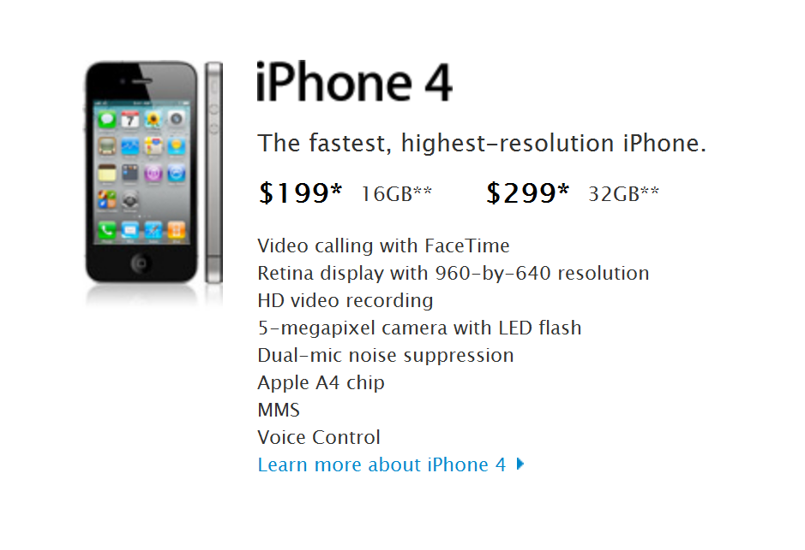

Slide 19
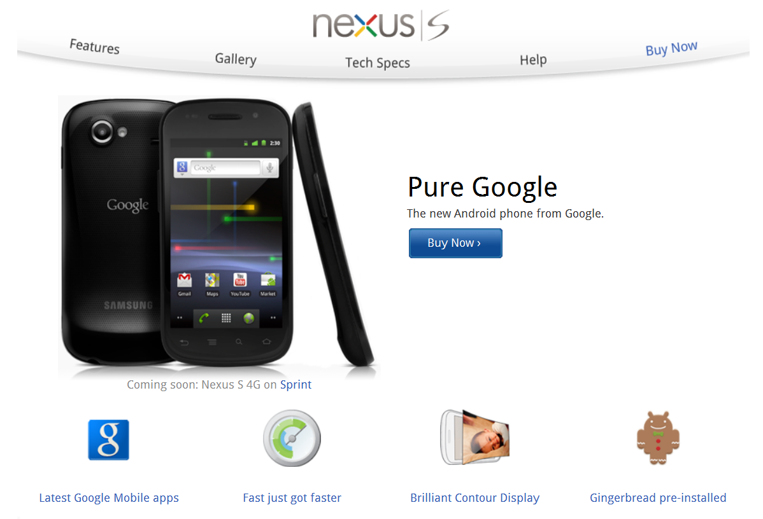

Slide 20
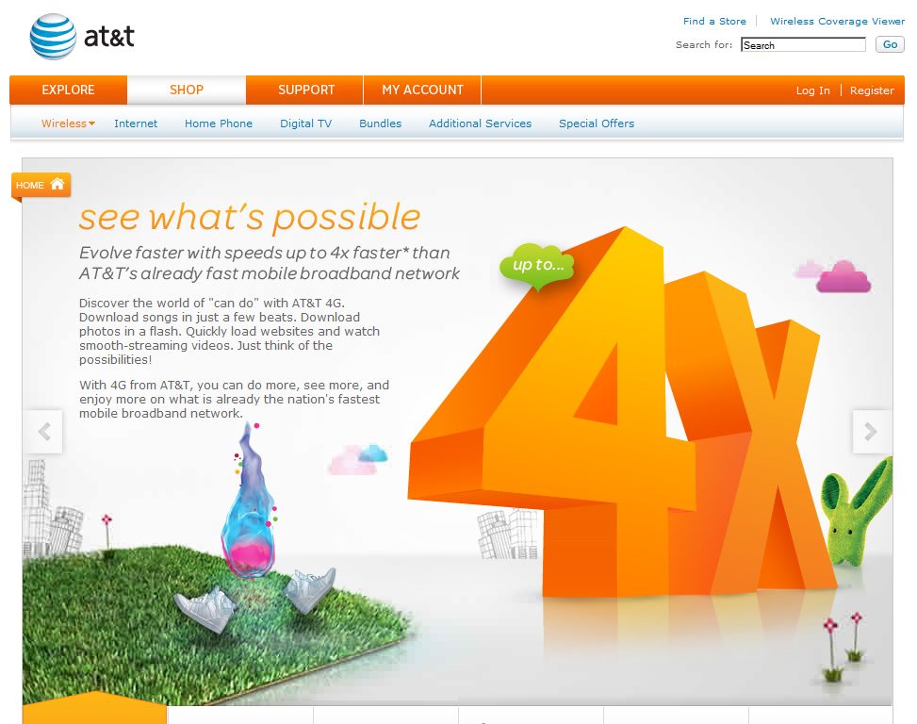

Slide 21
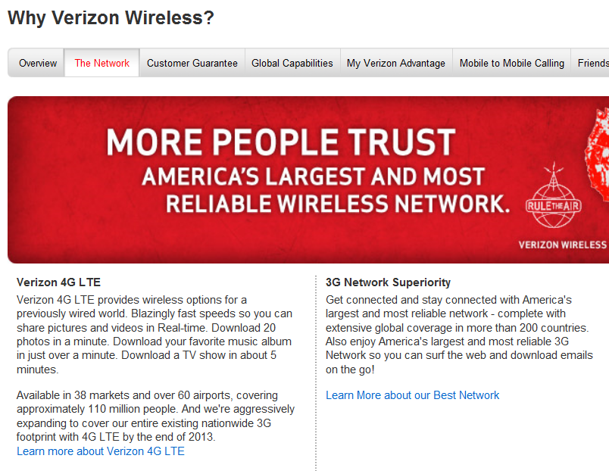

Slide 24
zero visibility
flickr.com/photos/davidandheidi/2320489837/

Slide 25
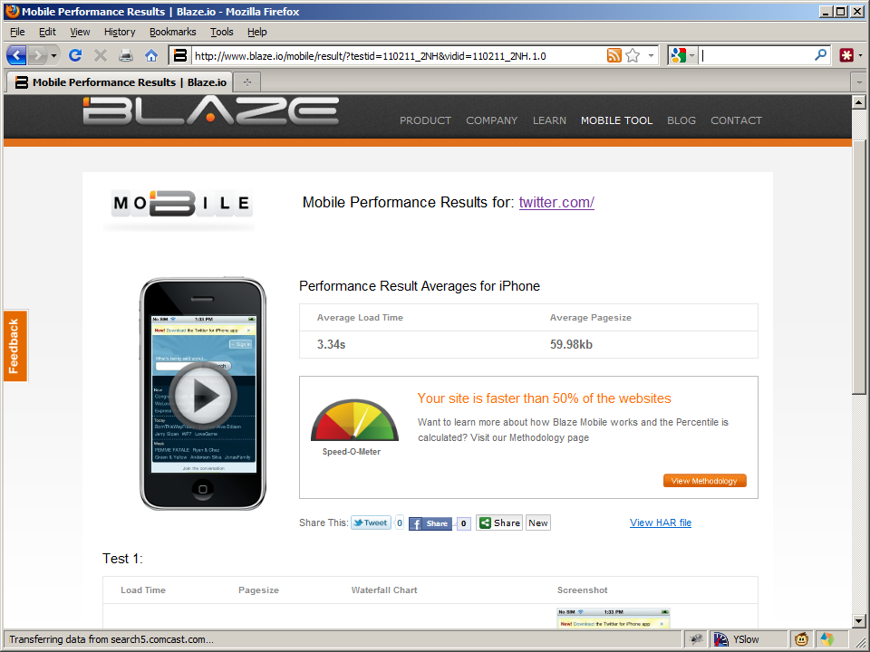
1

Slide 26
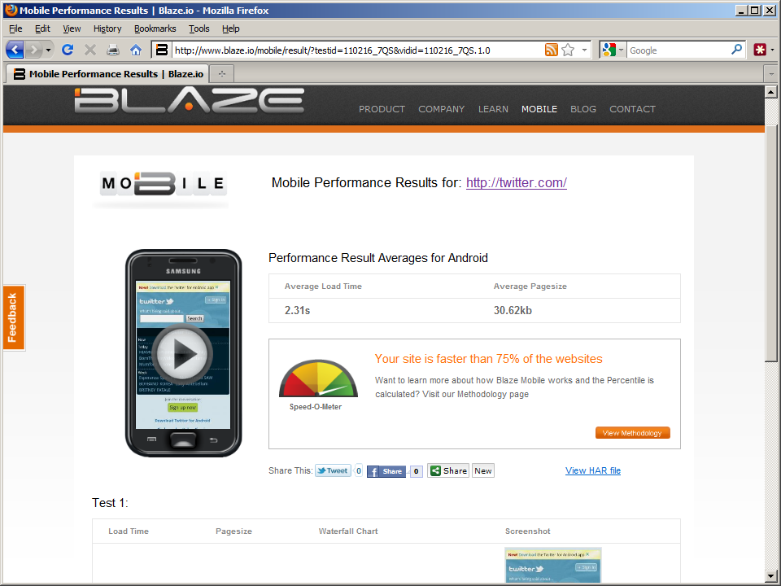

Slide 27
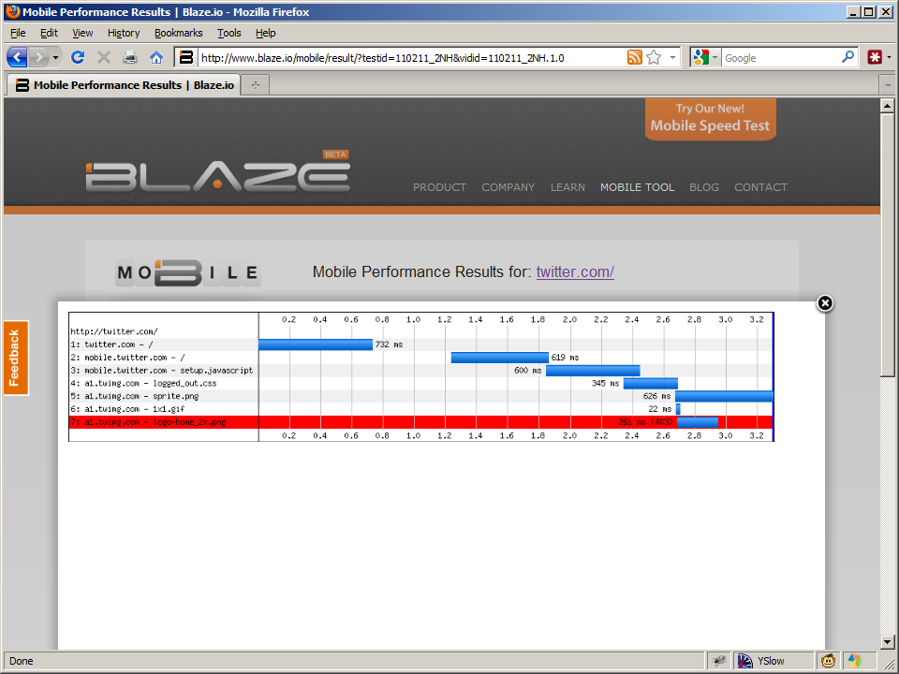

Slide 28
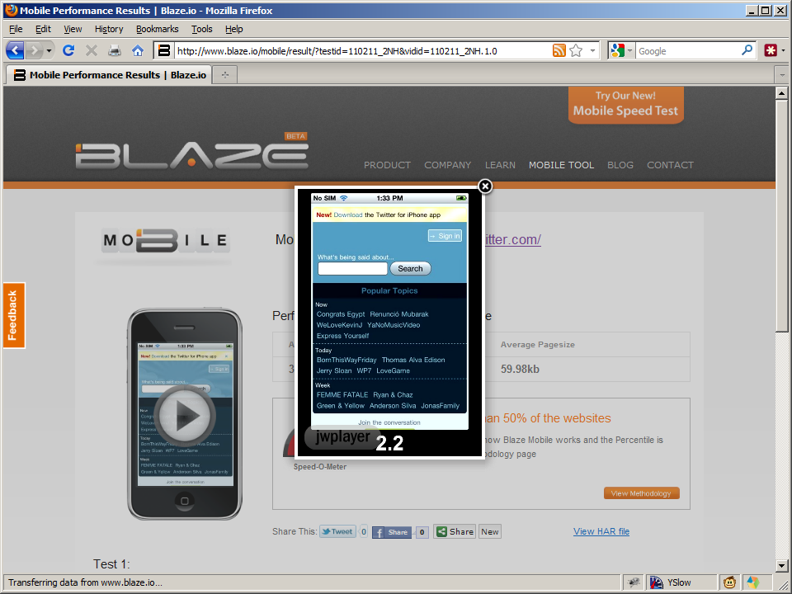

Slide 29
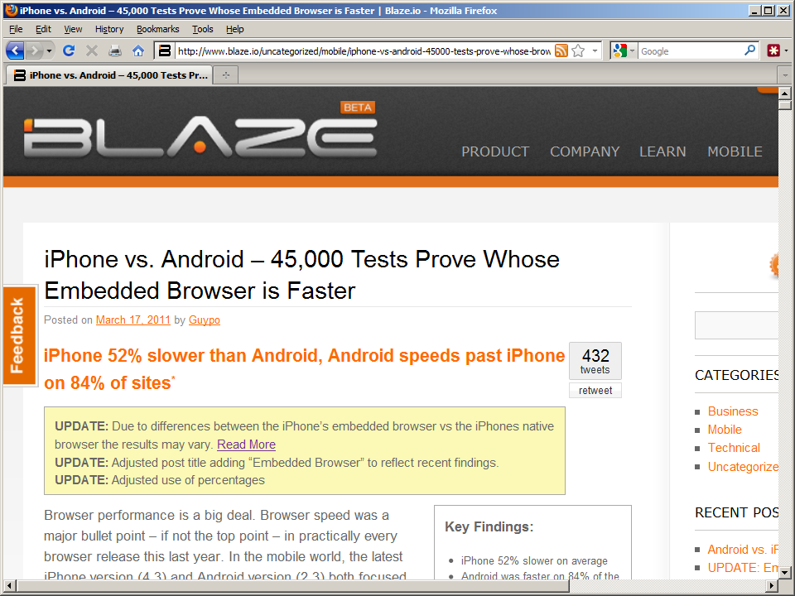

Slide 30
2

Slide 31
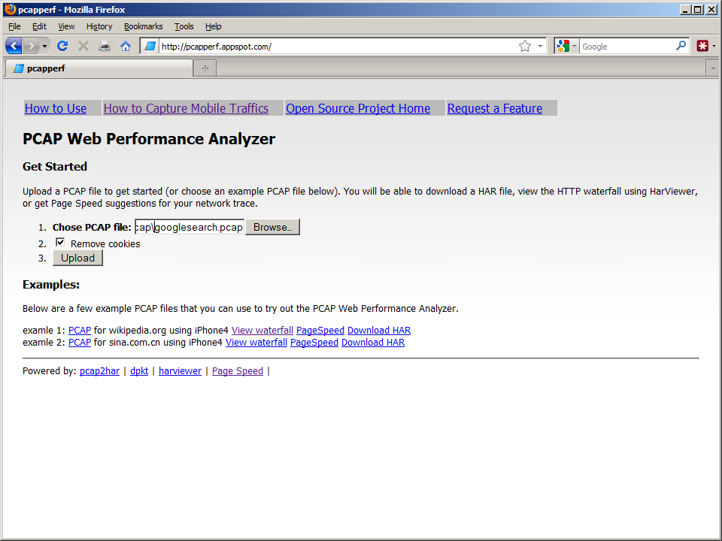

Slide 32
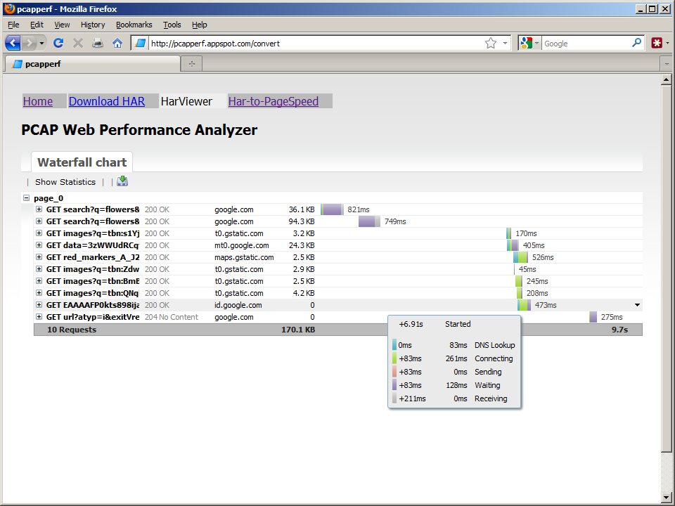
to intr
to intr

Slide 33
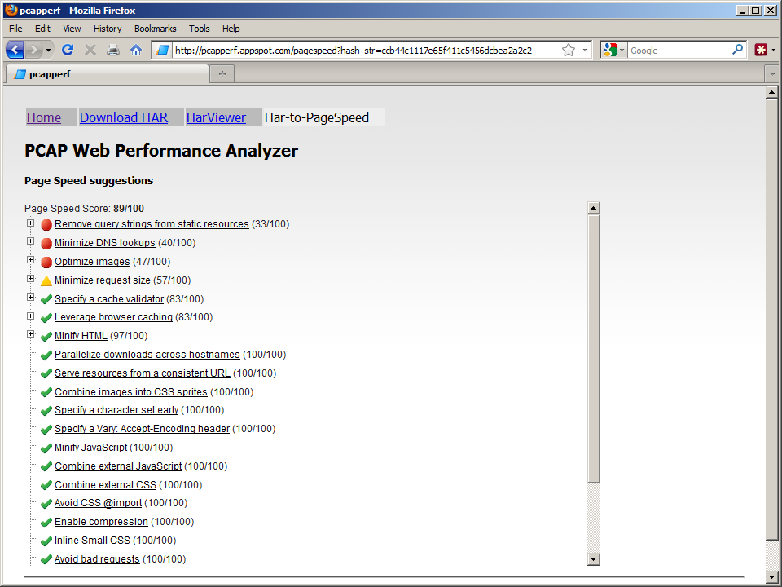

Slide 34
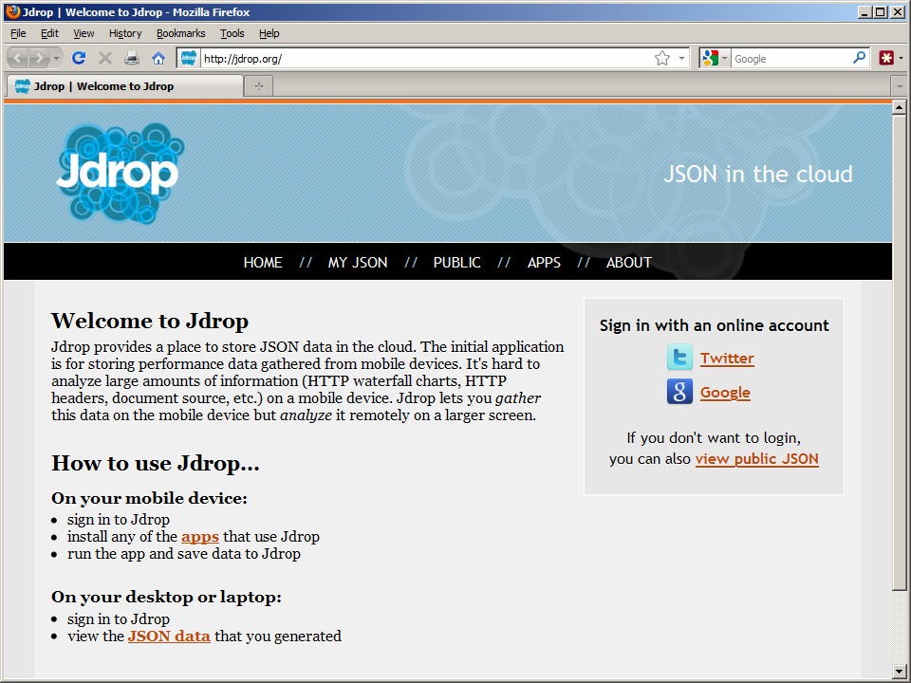
3

Slide 36
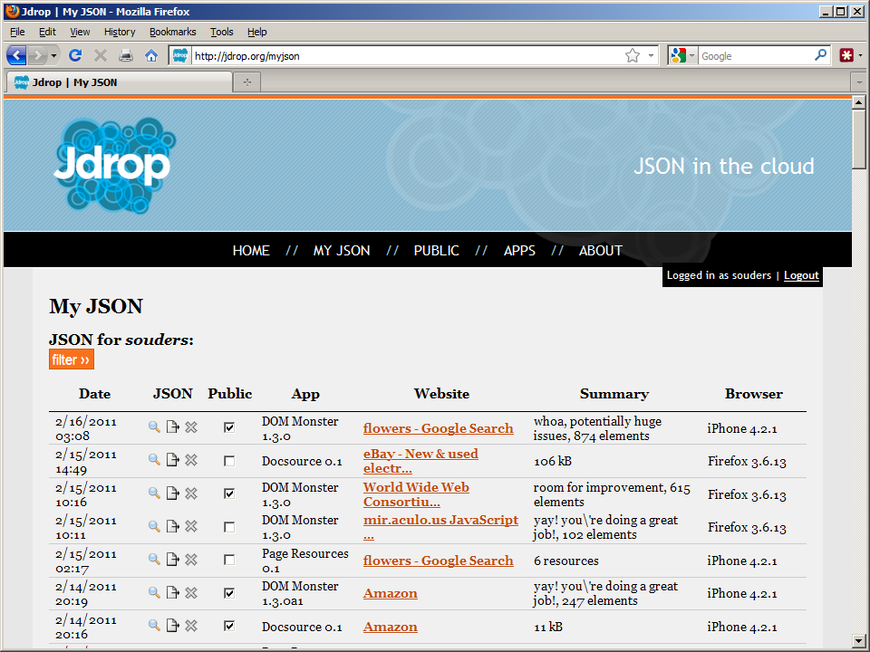

Slide 37
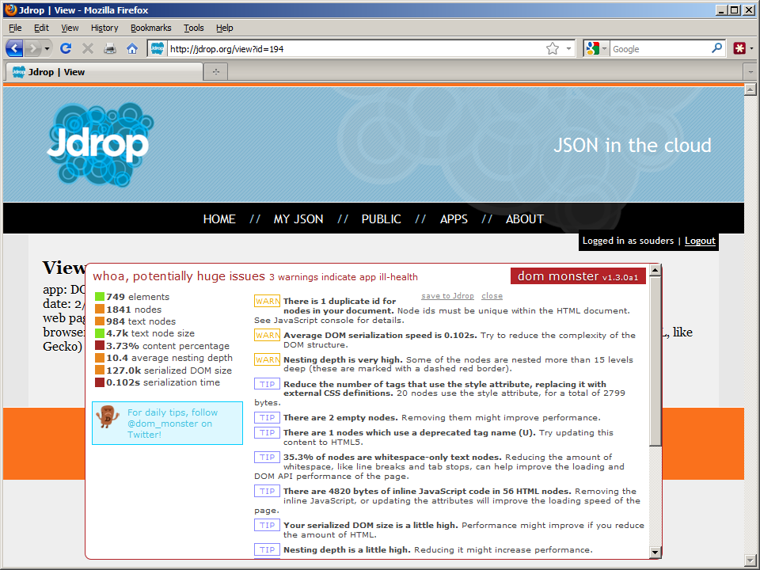

Slide 38
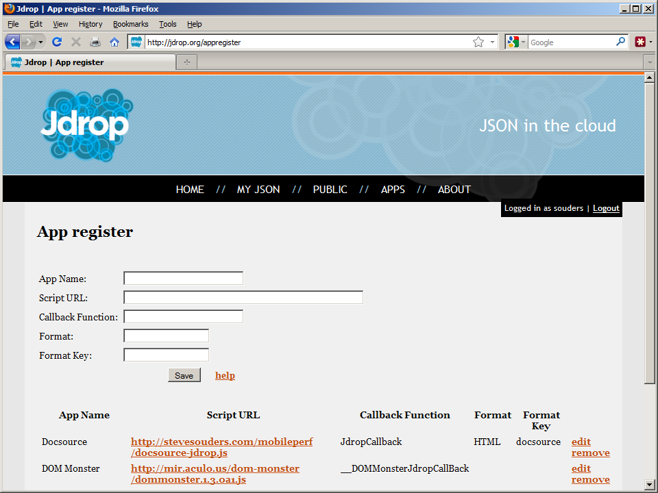

Slide 39
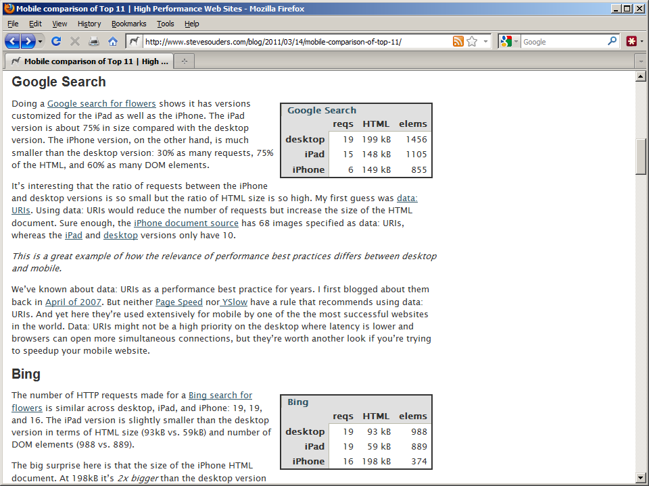

Slide 40
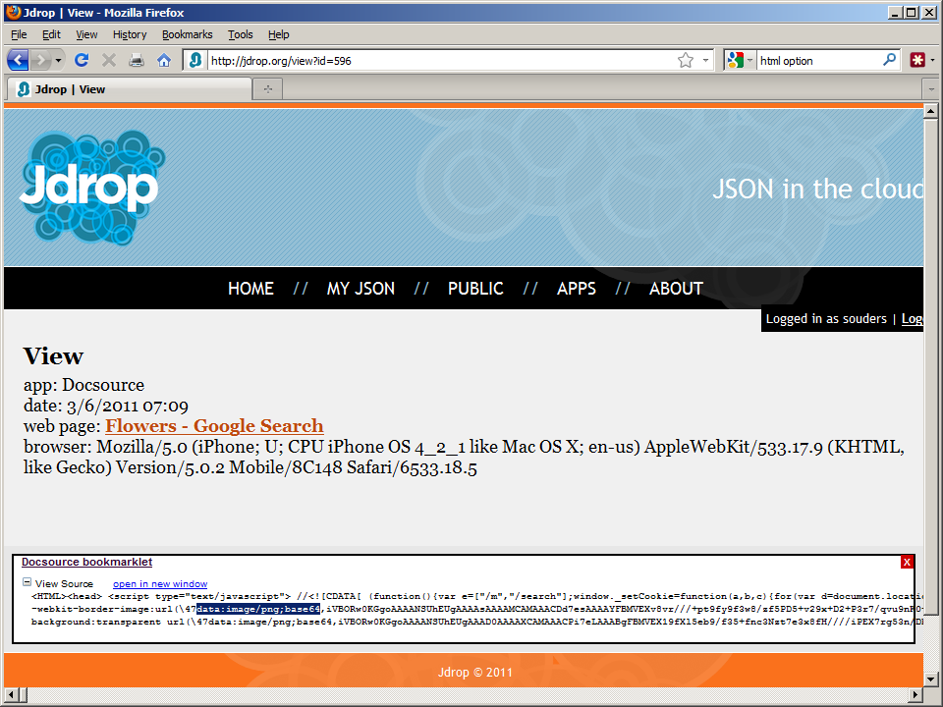

Slide 42
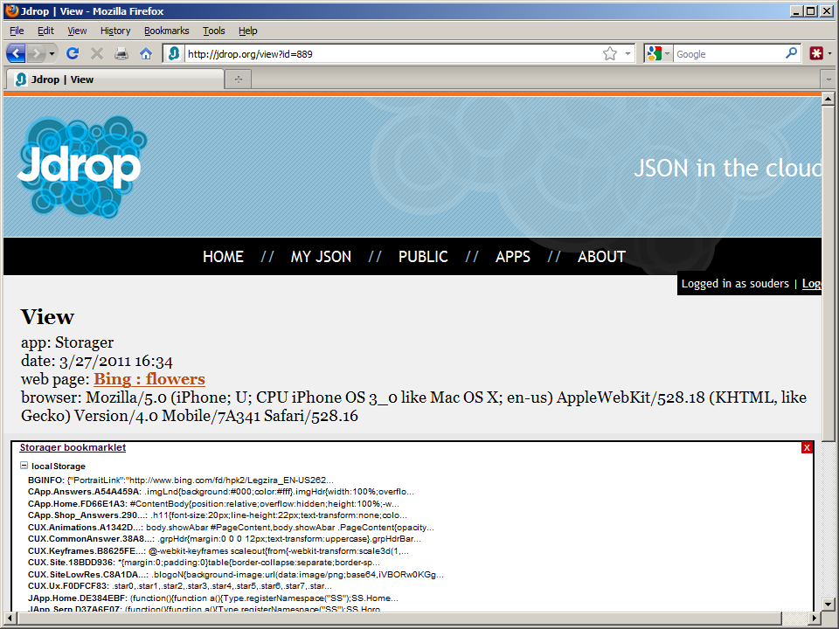

Slide 43
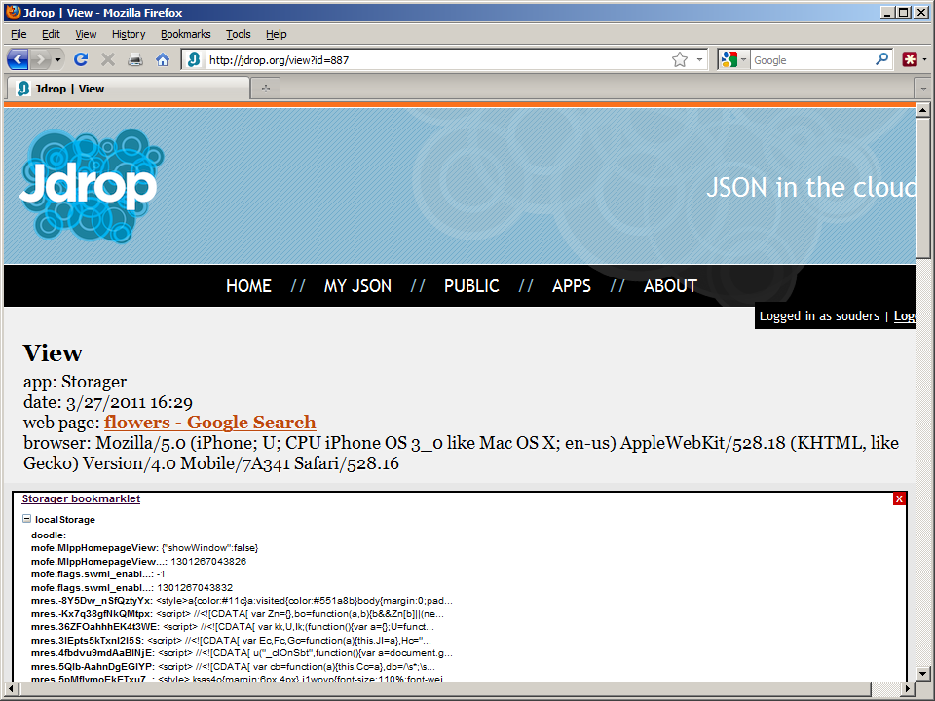

Slide 44
takeaways
speed matters
WPO
traffic↑, UX↑, revenue↑, costs↓
faster mobile
biz opp, differentiator, shared pain
visibility into mobile
pcapperf, Blaze.io, Jdrop

Slide 45
announcing
the HTTP Archive

Slide 46
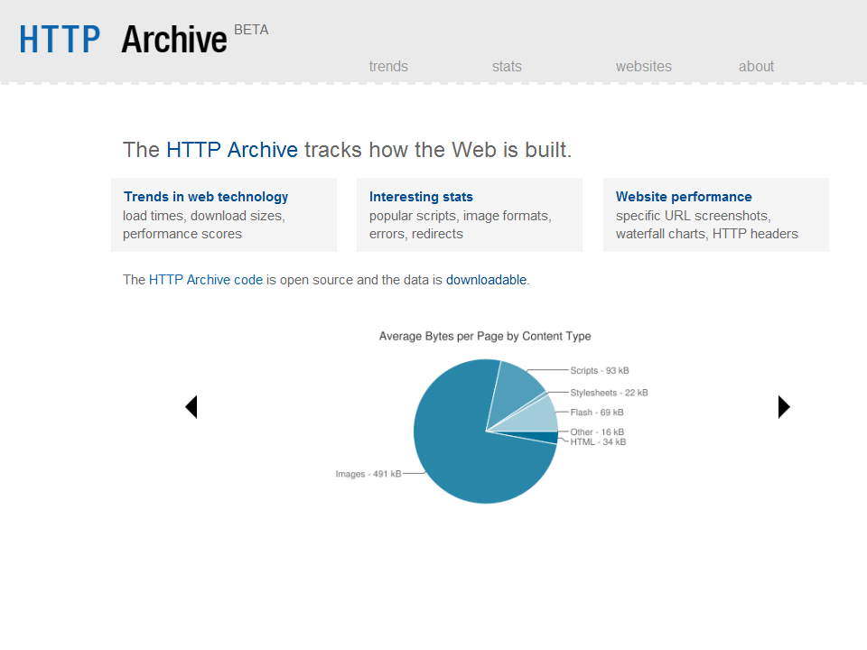

Slide 47
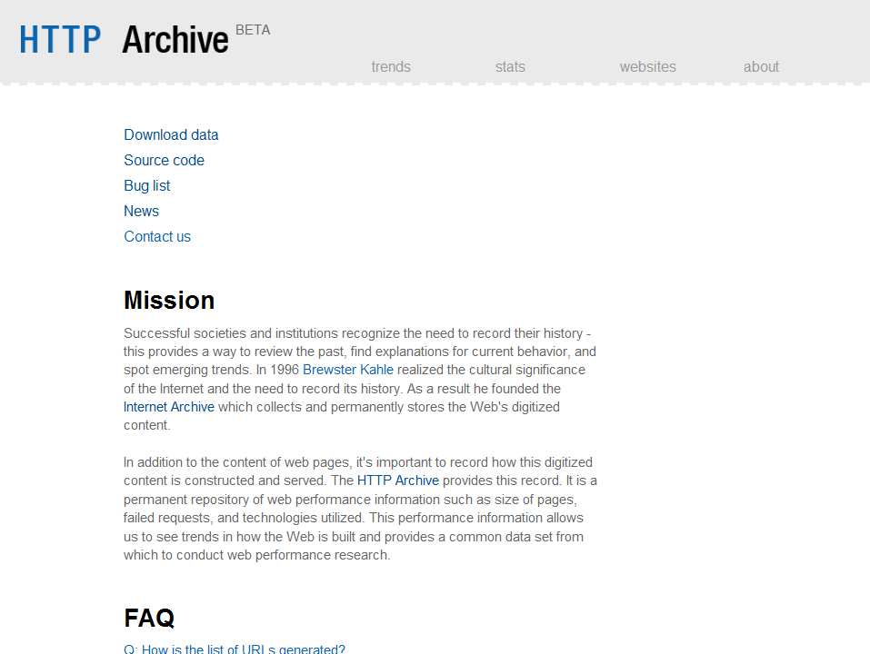
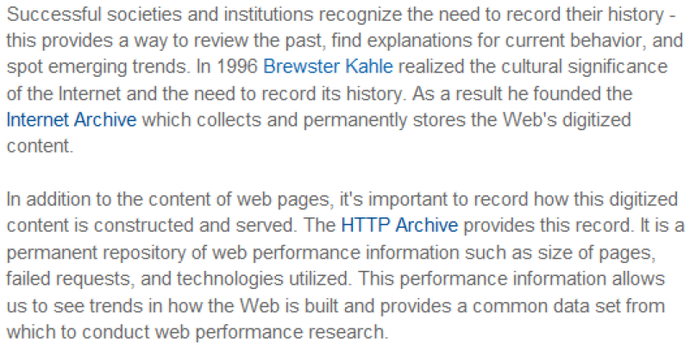

Slide 48
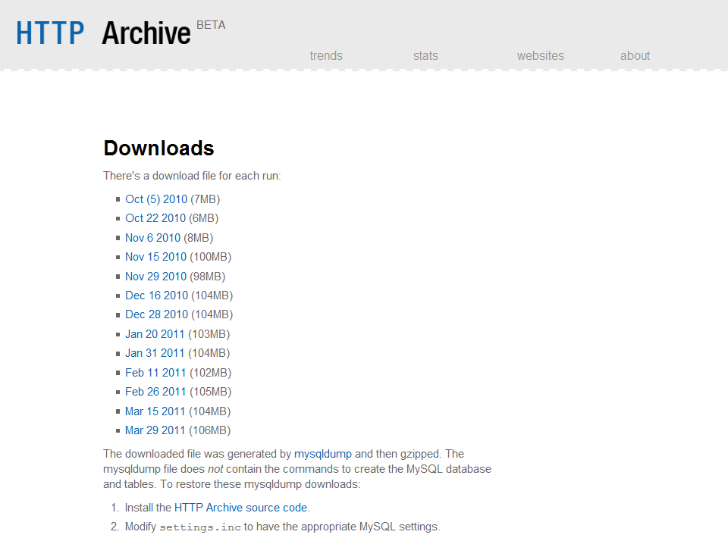

Slide 49
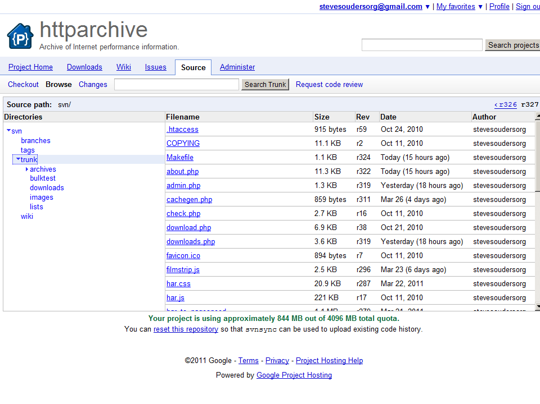

Slide 50
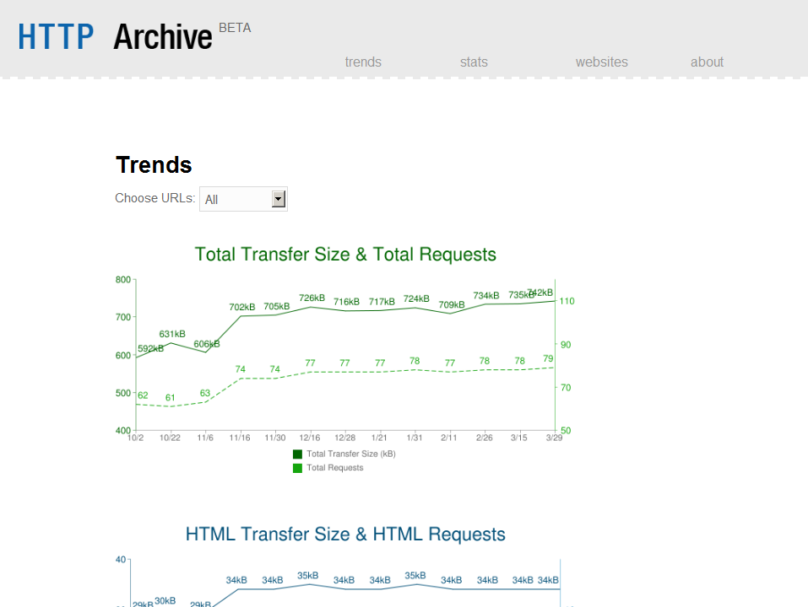

Slide 52
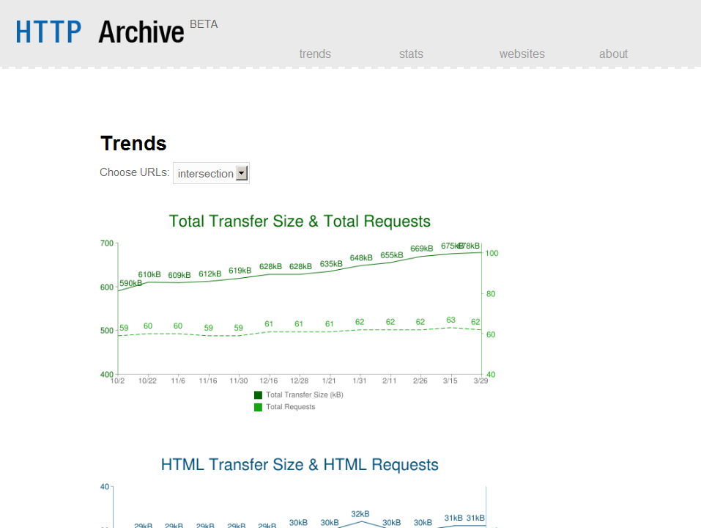
590 to 678 kB (15% bigger) in 6 months

Slide 53
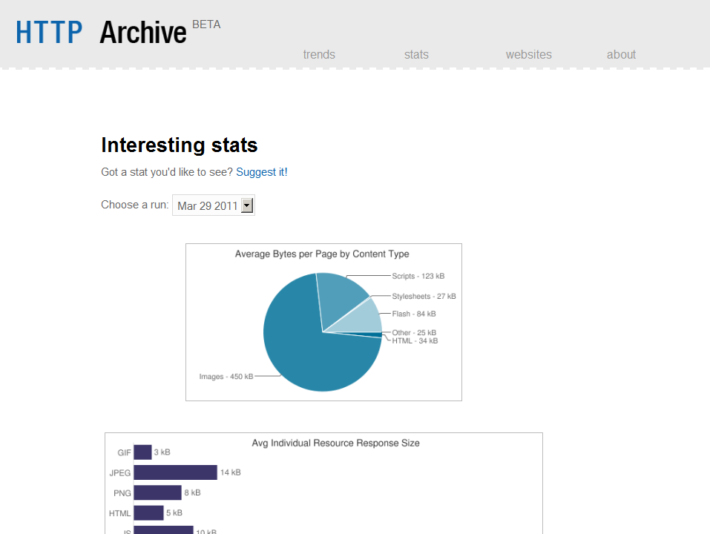

Slide 54
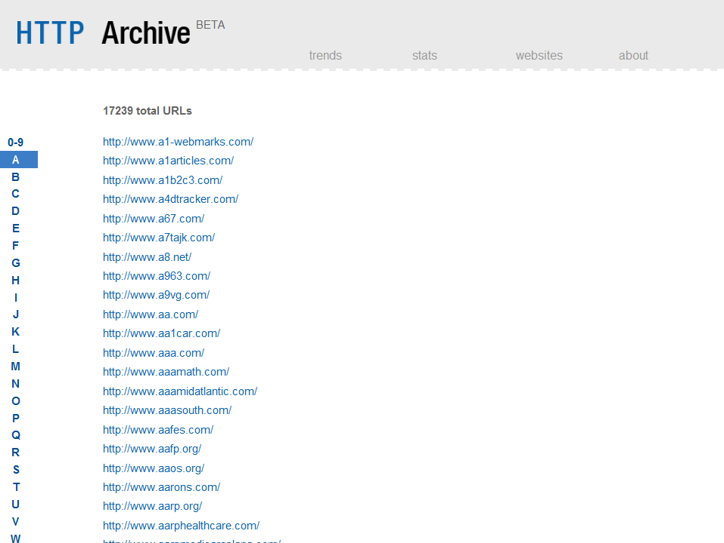

Slide 55
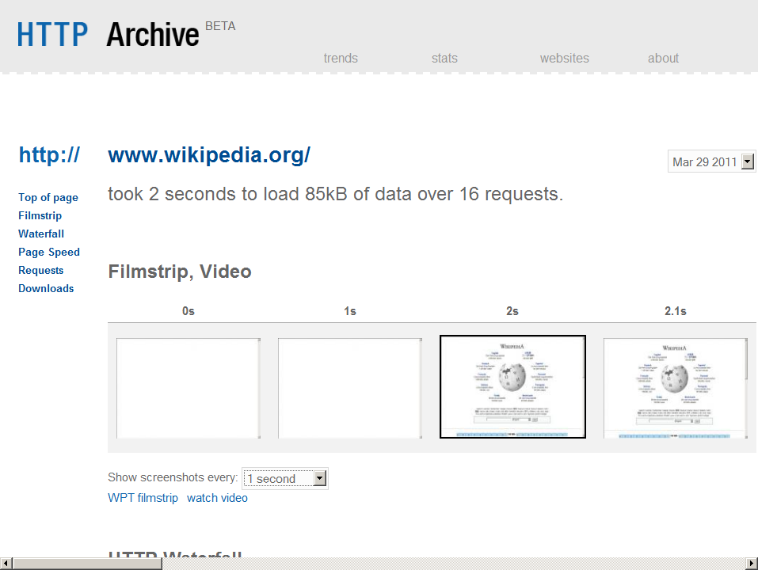

Slide 56
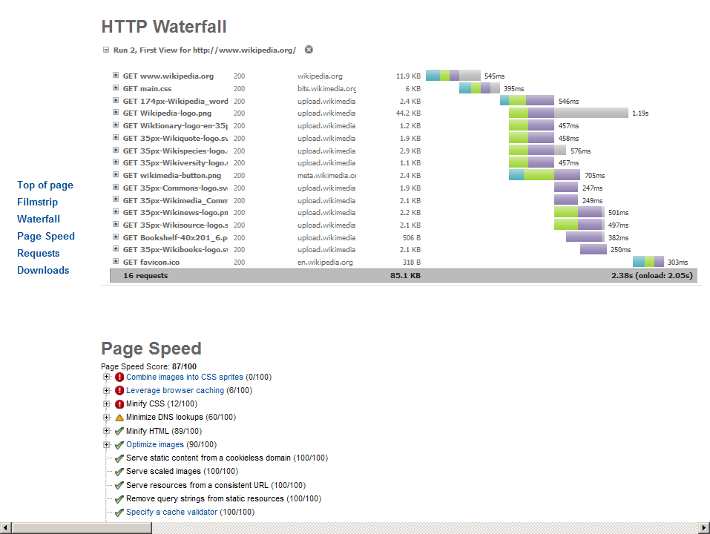

Slide 57
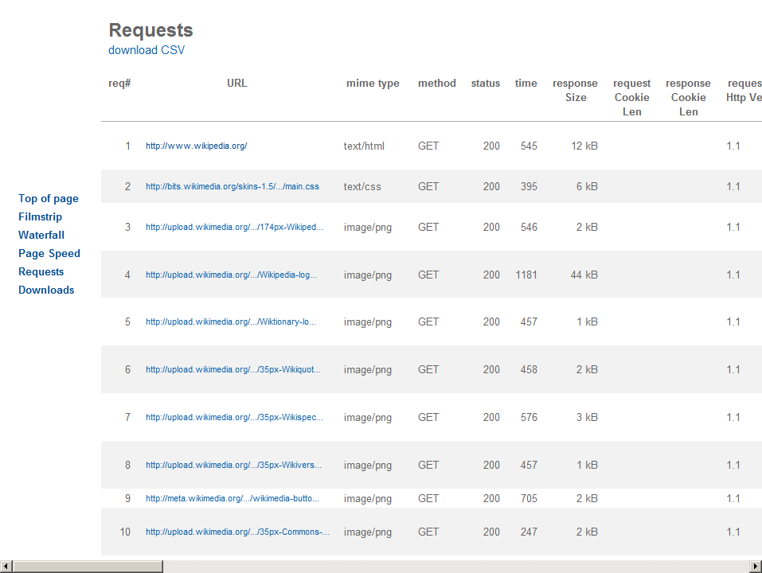

Slide 59
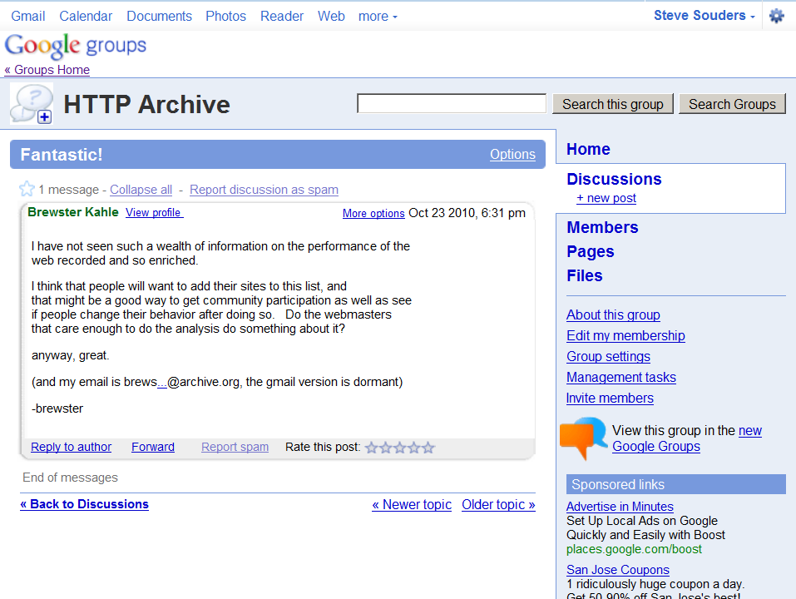

Slide 60
Steve Souders
@souders
stevesouders.com/docs/web20expo-20110330.pptx
flickr.com/photos/myklroventine/4062102754/
Notes:
http://www.flickr.com/photos/myklroventine/4062102754/

